Slide 1

STAY CONNECTED
Training Programme for HR Professionals and Managers
Module 6
Action planning: Using project resources in everyday hybrid work practices

Slide 2

Energizer
Hybrid Collaboration Connections
Notes:
Introduction (1minute):
"We're about to dive into action planning for hybrid work, which is all about finding the best way to connect and collaborate, no matter where we are. To get us warmed up, let's do a quick activity called 'Hybrid Collaboration Connections.'"
"We'll be using a combination of physical and virtual actions to find common ground."
The Activity (5-7 minutes):
Round 1: "Physical Connection"
"If you're in the room, stand up. If you're remote, turn your camera on. Now, if you've ever worked from a non-traditional workspace (like a coffee shop, park, or your couch), raise your hand (or use the raise hand function). If you have a pet that has interrupted a meeting, wave. If you have had to mute yourself due to background noise, do a little shimmy."
Ask people to share a quick 1-2 word reply about how they felt during those experiences.
Round 2: "Virtual Connection"
"Now, let's try some virtual connections. In the chat, type one word that describes your ideal hybrid work setup. Or, use an emoji that represents your favorite remote work tool. Now, if you have used the reaction buttons in a meeting today, give us a thumbs up reaction."
Quickly scan the chat and call out a few interesting responses.
Debrief (1-2 minutes):
What did you notice? How did it feel to connect in these different ways? This shows us how diverse our experiences are, and how important it is to be flexible and inclusive in our hybrid work plans. Let's carry this spirit of connection into our action planning session."

Slide 3
Module aim and outline
Develop practical, resource-driven action plans
Effective use of resources
Enhance productivity, collaboration, and project success
Meet hybrid team goals are met
This module is divided into the following 3 main topics:
Resource Allocation Strategies for Hybrid work environments
Action Plan Development for Hybrid work strategies
Monitoring and Adjusting Resource usage
Notes:
This module teaches participants to develop practical action plans for integrating project resources into their everyday hybrid work practices, ensuring that resources are used effectively and team goals are met with the aim of creating actionable, resource-driven plans that help them utilise project resources effectively in their hybrid work routines, enhancing productivity, collaboration, and project success.

Slide 4

The STAY CONNECTED toolkit and the previous training modules have covered the success factors for hybrid work and hybrid teams.
In a hybrid work environment, it is also crucial to know how to effectively use available project resources (such as time, people, tools, and budget) to support daily work processes and goals.

Slide 5
Topic 1
Resource Identification and Allocation

Slide 6


Topic 1: Resource Identification and Allocation
Its benefits include:
  Optimised productivity
  Prioritizing work
  Managing risks
  Enhancing decisions
  Bringing growth and innovation

Slide 7
Topic 1: Resource Identification and Allocation to create an Action Plan
Resource allocation is the assigning and distributing of available resources, such as:
financial capital
workforce
equipment, and
time
among different activities, projects, or departments within an organisation.

Slide 8
Topic 1: Resource Identification and Allocation
Effective resource allocation in hybrid work environments is crucial for maximising productivity and ensuring seamless collaboration between remote and in-office teams.
Strategic distribution of resources such as time, tools, budget, and personnel, can address the unique challenges of hybrid work in organisations, reduce bottlenecks, and enhance overall efficiency.
Proper resource allocation fosters a sense of equity and support among team members, enabling them to perform their roles effectively and contribute to the achievement of project goals.
Ultimately, it helps create a balanced and adaptable work environment that can respond to changing demands and opportunities.

Slide 9


Activity 1: Group exercise - Resource allocation in a hybrid team.
The aim of this activity is for participants to understand how to allocate resources in a project task, making necessary adjustments to accommodate for hybrid team dynamics.
Learning new knowledge
After the completion of this activity, you will be able to:
List various resources available in hybrid work
Choose effective methods for allocating and managing resources in hybrid settings
Adjust for group dynamics

Slide 10

Activity 1: Group exercise - Resource identification and allocation in a hybrid team
Scenario
You have been assigned, as a Project Manager, to lead a hybrid team of 5 IT developers of varying experience levels, working on a new platform over the course of 2 years. One of the team members is a local, new hire, another is a foreign national who works fully remotely from another country, in a different time zone, and the rest of the team members work some days from home and some in the office.
STEP 1
In your designated groups, reflecting on the information presented to you in the previous modules and using information available from the Toolkit, identify the various resources available in your hybrid work settings (e.g. digital tools, team members’ roles, etc) and list them.
STEP 2
Each group presents their list and discusses methods for allocating and managing these resources effectively for the team to work productively
STEP 3
Reflect on what is presented and summarise key points emerging
00h:20m
Notes:
Note for facilitator: When debriefing, emphasize the need for flexibility and adaptability in resource management. Consider whether the participants identified things like working in different time zones, onboarding in a hybrid mode, cultural sensitivity and using a common language in communication.

Slide 11

Activity 1: Group exercise - Resource allocation in a hybrid team
RESOURCES
https://asana.com/resources/resource-allocation
Resource Allocation: Definition, Methods and Examples | Glossary
https://www.workast.com/blog/why-understanding-resource-allocation-helps-in-hybrid-work-models/
https://www.bighand.com/en-us/resources/case-studies/taylor-wessing-optimises-work-allocation-to-support-hybrid-working-and-career-development-with-resource-management/
Learn more!
4 Best Resource Allocation Methods In Project Management

Slide 12
Topic 2
Action Plan Development

Slide 13
Topic 2: Action Plan Development
By outlining specific tasks and designating who is responsible for each of them, an action plan ensures that all team members understand their roles and deadlines, fostering accountability and transparency.
This clarity enhances collaboration and communication, as team members can easily track progress and coordinate efforts.
Additionally, by strategically allocating resources such as time, tools, and personnel, an action plan helps optimize resource utilization, reducing inefficiencies and ensuring that both remote and in-office teams have what they need to succeed.
Ultimately, a well-crafted action plan supports a cohesive and productive hybrid work environment, enabling teams to achieve their goals effectively.

Slide 14
Topic 2: Action Plan Development
A well-defined action plan should have:
Clear objectives to work towards
Detailed steps to be followed
Assigned roles and responsibilities (who is expected to do what)
Timelines (estimated completion timeframes, milestones, deadlines)
Identification of resources (e.g. time, tools, infrastructure, employees)
Clear allocation of the resources

Slide 15
Topic 2: Action Plan Development
Checklist of elements necessary for an inclusive and successful hybrid work environment:
Do you have clear policies on remote / hybrid work, flexible working?
Do you have the technology and infrastructure to support hybrid work?
Do you have clear communication processes?
Do you have the right Health & Safety measures in place to support hybrid workers?
Does your organisational culture foster trust and accountability?
Does leadership support employee wellbeing and engagement?
Do your policies and people leaders support equality, equal opportunities, diversity and inclusion?
Are your work resources accessible to all?
Are hybrid team goals, roles, purpose, processes, values and processes clear?
Are hybrid meeting set-ups sufficient?

Slide 16
Activity 2: Creating an action plan
        The aim of this activity is to practice developing action plans for hybrid teams and hybrid work settings.
Learning new knowledge
After the completion of this activity, you will be able to:
Demonstrate how well-defined action plans contribute to project milestones, reduce bottle-necks and improve resource utilisation
Create specific action plans that outline how project resources will be used to achieve tasks and goals in both in-office and remote environments

Slide 17
Activity 2: Drafting a sample action plan
Scenario
Building on the scenario and outcomes of Activity 1, and using the Action Plan template provided (handout) each participant is tasked with creating an action plan for their newly created project team. The Team Leaders must outline how they will use resources to achieve collaborative tasks and goals in both in-office and remote environments, while maintaining employee wellbeing, engagement and morale within the team, without making anyone feel excluded.
STEP 1
In assigned pairs, each person must share and present their action plan and strategy.
STEP 2
Each person must provide feedback and suggestions for improvement to the other.
STEP 3
All participants participate in a debrief to discuss what the optimal action plan looks like.
00h:20m

Slide 18

Activity 2: Drafting a sample action plan
RESOURCES
Hybrid working: Guidance for people professionals | CIPD
10 First Steps To Creating A Productive Hybrid Work Environment
6 Ways To Create A Successful Hybrid Work Model
What’s a Modern Hybrid Workplace Strategy? (and How to Create One) | Robin
Learn more!
What’s a Modern Hybrid Workplace Strategy? (and How to Create One) | Robin

Slide 19
Topic 3
Monitoring and Adjusting Resource Usage

Slide 20
Topic 3: Monitoring and Adjusting Resource Usage
4 Key Benefits of Monitoring and Adjusting Resource Usage in Hybrid Work
1. Optimized Resource Allocation:
Identifying underutilized resources: By tracking resource usage, areas where resources are not being fully utilized can be identified.
Reallocating resources allows for redistribution of resources to high-priority projects or teams that need additional support.
2. Improved Productivity:
Enhanced efficiency: By monitoring resource usage, bottlenecks and inefficiencies can be identified in workflows.
Optimised workload distribution: to ensure fair and efficient workload distribution among team members.
Notes:
Monitoring and adjusting resource usage in a hybrid work setting is crucial for maximizing productivity, employee satisfaction, and overall business efficiency.

Slide 21
Topic 3: Monitoring and Adjusting Resource Usage
4 Key Benefits of Monitoring and Adjusting Resource Usage in Hybrid Work
3. Enhanced Employee Satisfaction:
Reduced burnout: Workload monitoring can prevent employees from being overworked and getting burned out.
Increased flexibility: Through resource allocation optimization, employees can be offered more flexibility in their work arrangements.
4. Cost Reduction:
Reduced operational costs: By identifying and eliminating unnecessary resource usage, operational costs can be decreased.

Slide 22
Topic 3: Monitoring and Adjusting Resource Usage
Methods for Monitoring and Adjusting Resource Usage
Project Management Tools: Utilize project management tools like Asana, Trello, or teamwork to track project progress, resource allocation, and task assignments.
Time Tracking Software: Implement time tracking software to monitor how employees spend their time on different tasks and projects and estimate efforts.
Employee Surveys and Feedback: Regularly gather feedback from employees to understand their workload, challenges, preferences and resource needs in a hybrid work environment.
Regular Check-ins and Meetings: Conduct regular check-ins and team meetings to discuss resource allocation, project priorities, and any issues that may arise.
Data Analytics: Use data analytics tools to analyze resource usage patterns, identify trends, and make informed decisions.

Slide 23
Activity 3: Monitoring and adjusting your action plan for success
        The aim of this activity is to evaluate a project’s resource allocation and propose adjustments for optimization.
Learning new knowledge
After the completion of this activity, you will be able to:
Evaluate the importance of careful resource allocation and planning to achieve project goals in hybrid settings.
Build a sense of ownership and responsibility over resource management.
Implement a tracking process for resource usage, identify inefficiencies and make adjustments in the implementation of hybrid work.

Slide 24
Activity 3: Monitoring and adjusting your action plan for success
Scenario
You implemented your action plan developed from activities 1 & 2 previously.
Using your project management tool of choice and having monitored the team members’ performance for 3 months you notice different productivity levels which are affecting the project’s timelines.
You want to support your team members so you ask for their feedback, individually, to identify the root cause(s) of the discrepancies. You realise the following:
2 team members feel isolated from the rest of the team and don’t feel comfortable asking for support
Your most experienced team member is not proactively sharing knowledge with the others, especially the new joiner.
Your remote team member is going through a serious health issue and has just informed you that he needs to have regular doctor’s appointments that often conflict with the online team meetings.

Slide 25
Activity 3: Monitoring and adjusting your action plan for success
STEP 1
What will you do to rectify the situation and avoid missing deadlines for the project?
Note down your next actions and update your current action plan.
STEP 2
Present your adjusted action plan and discuss in the group.
00h:15m

Slide 26

Activity 3: Monitoring and adjusting your action plan for success
RESOURCES
https://www.hrmagazine.co.uk/content/features/make-hybrid-work-healthy-work/
https://www.workstatus.io/blog/project-management/keep-track-of-time-spent-on-projects/#:~:text=By%20taking%20advantage%20of%20time,much%20time%20spent%20on%20projects.
https://www.hrmagazine.co.uk/content/comment/making-the-right-call-on-hybrid-work
https://workleap.com/blog/why-conducting-employee-feedback-analysis-is-so-important/
Learn more!
https://cadabra.studio/the-power-of-data-analytics-for-decision-making/

Slide 27
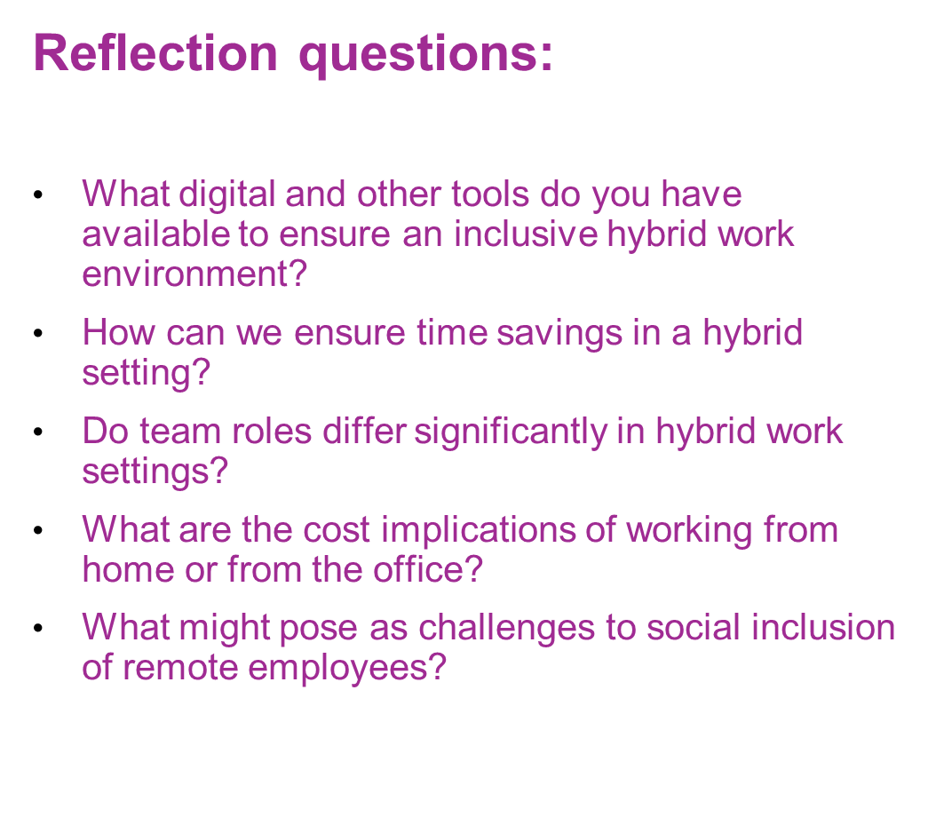


Slide 28

Assessment activity
1. “Resource allocation does not affect decision making.”
Is this statement True or False?
A) True
B) False
2. Tick/choose which of the below policies are NOT important in implementing a successful Hybrid Work environment (Choose as many as are applicable).
A) Clear communication policy
B) Flexible work schedule policy
C) Technology and IT support policy
D) Strict in-office attendance policy
Designed by freepik

Slide 29
Assessment activity
3. Is it necessary to assign roles and responsibilities in team members working in hybrid settings? Yes or No
A) Yes
B) No
4. Which of the below are key benefits of Monitoring and Adjusting Resource Usage in Hybrid Work? (Choose as many as are applicable)
A) Improved productivity and efficiency
B) Better alignment between remote and in-office teams
C) Ability to quickly identify underutilized resources
D) Enhanced employee satisfaction and engagement
E) All of the above
Designed by freepik

Slide 30
Assessment activity
5. Choose which methods can be used for monitoring your action
plan for implementing a hybrid work environment.
A) Regular employee feedback surveys
B) Utilizing project management tools and dashboards
C) Monitoring in-office attendance
D) All of the above
Designed by freepik

Slide 31

Content developer of Module
Institute of Development, Cyprus
Website: www.instituteofdevelopment.eu
Email: info@iodevelopment.eu

Slide 32









Funded by the European Union. Views and opinions expressed are however those of the author(s) only and do not necessarily reflect those of the European Union or the European Education and Culture Executive Agency (EACEA). Neither the European Union nor EACEA can be held responsible for them. Project Number: 2023-1-BG01-KA220-VET-000153460

