Slide 1



Training programme for HR professionals and Managers
Module 5 Best practices for technology implementation in hybrid teams

Slide 2
Module aim and outline
This module is designed to equip participants with the knowledge, skills, and attitudes needed to effectively integrate technology into hybrid work environments. It offers a hands-on approach to exploring tools and techniques that enhance productivity, communication, and collaboration. By the end of the module, learners will have gained familiarity with essential tools like Zoom and Asana, enabling them to optimize team performance. Participants will develop practical skills such as setting up virtual collaboration spaces, managing tasks, and balancing synchronous and asynchronous communication. They will also cultivate a positive and adaptive mindset, recognizing the importance of experimenting with new technologies to create inclusive and sustainable hybrid work processes.
This module is divided into the following topics:
Topic 1 Technology’s Role in Hybrid Work
Topic 2 Tools for Hybrid Collaboration, Communication and Task Management
Topic 3 Balancing Technology Use and Avoiding Burnout

Slide 3

Topic 1 Technology’s Role in Hybrid Work
Notes:
DELETE ALL NOTES AT THE END
- include LU number and title

Slide 4



Topic 1: Technology’s Role in Hybrid Work
What is the technology´s impact on hybrid team dynamics?
It plays a vital role when facilitating collaboration and communication
Since the pandemic there has been an increase of collaboration tools:
2019 42%
2020 66%

Slide 5
Topic 1: Technology’s Role in Hybrid Work
What are the purposes of using advanced tools?
Creation of an immersive virtual environment
To be user-friendly, enhancing employee engagement and satisfaction
Offer a robust cybersecurity
Empower companies to build strong, secure and efficient hybrid teams.

Slide 6

Topic 1: Technology’s Role in Hybrid Work
Technology adoption strategies
Best practices
Establishing a cross-functional change team and appointing a project manager
Audits at entry levels
Cultivating a culture of open collaboration
Training

Slide 7
Topic 1: Technology’s Role in Hybrid Work
Technology adoption strategies
Barriers
Resistance to change
Security concerns
Limited access to technology
Shortage of digital skills

Slide 8
Topic 1: Technology’s Role in Hybrid Work
What are the differences between
synchronous and asynchronous communication?

Slide 9

Synchronous methods
Meetings and calls for addressing immediate questions.
Advantages
Highly effective for urgent calls
Allows immediate feedback
Drawbacks
Can disrupt focus work
Challenging to coordinate if there are time zone differences

Slide 10

Asynchronous methods
Team members have all of the information shared
Advantages
Provides flexibility
Enables better concentration
Reduces workflow disruption
Drawbacks
Difficult to maintain clarity
Delays in consensus building

Slide 11


Activity #1: Discussion on technology use
Activity Outline
Activity Objective
This activity encourages participants to reflect on their experiences with technology in hybrid work environments. It helps them identify both the benefits and challenges of these tools, setting the stage for deeper exploration of communication dynamics.
In small groups, participants share examples of technologies they use in hybrid teams and discuss their impact on collaboration and productivity. Each group presents one insight to the larger group, fostering shared learning and engagement.
0h:10m

Slide 12
Activity #1: Discussion on technology use
Activity Outline
How has it helped your team collaborate?
What challenges has it presented?
In small groups, participants share examples of technologies they use in hybrid teams and discuss their impact on collaboration and productivity. Each group presents one insight to the larger group, fostering shared learning and engagement.
0h:10m

Slide 13
Topic 2
Tools for Hybrid Collaboration, Communication and Task Management
Notes:
DELETE ALL NOTES AT THE END
- include LU number and title

Slide 14

Topic 2: Tools for Hybrid Collaboration, Communication and Task Management
Communication and Collaboration Tools
We are going to focus on...
Zoom Workplace
It is a powerful collaboration platform designed to support hybrid and remote work environments. It integrates communication and file sharing tools into a single workspace

Slide 15

Activity #2: Showcase of Communication Tools features
Zoom Workplace
0h:30m
Activity Objective
This activity demonstrates the key features of Zoom Workplace, highlighting how it supports both synchronous and asynchronous communication in hybrid teams.
Activity Outline
Participants then engage in a guided exercise where they practice setting up a channel, scheduling a meeting, and using the immersive space.

Slide 16
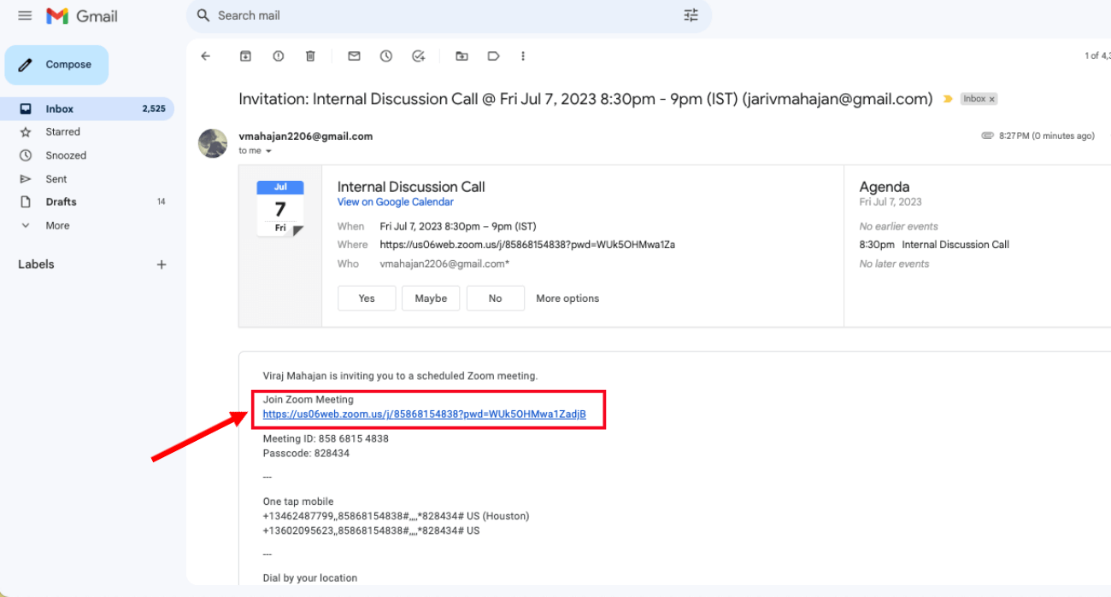
Activity #2: Showcase of Communication Tools features
How to join a meeting?
From the link in the email or calendar

Slide 17
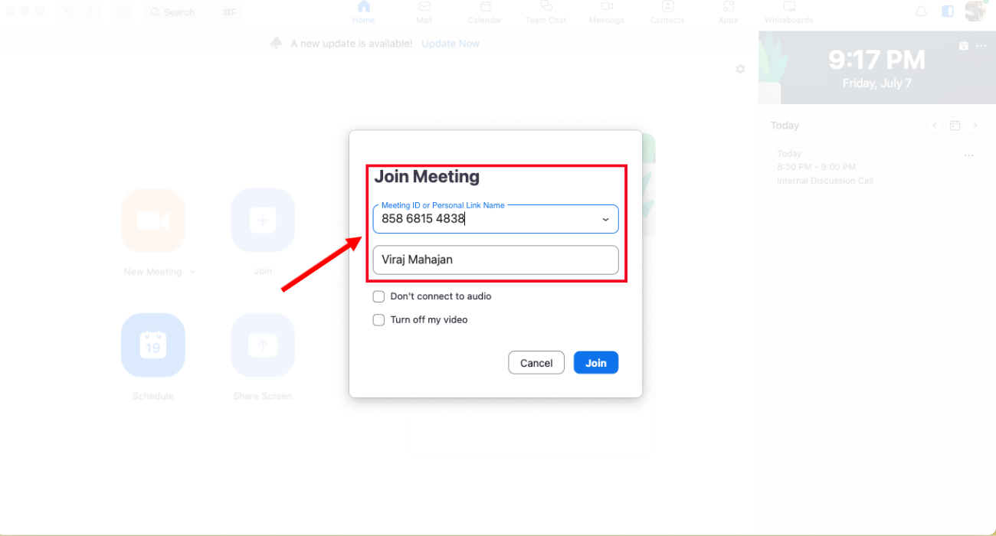
Activity #2: Showcase of Communication Tools features
How to join a meeting?
From a meeting ID

Slide 18
Activity #2: Showcase of Communication Tools features
Meeting control
Check who is in the meeting room
Members can react in the meeting with emojis
How to take meeting notes?
Start a meeting from the Zoom desktop app.
On the in-meeting controls, click the Notes button.
At the top right, click New.
A new note will open and can be edited or shared with the meeting.

Slide 19
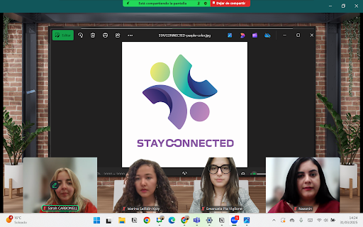
Activity #2: Showcase of Communication Tools features
What is an immersive view?
3D space for carrying out meetings
Perception of a face to face meeting
Easy way of building relationships

Slide 20
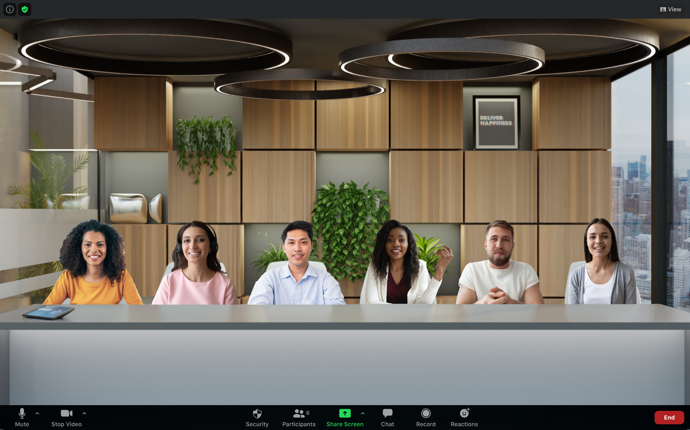
Activity #2: Showcase of Communication Tools features
How to start immersive view in a meeting?
Start a meeting or webinar as the host.
In the top-right corner, click View.
Click Immersive.
Select one of the following options for placing participants into the scene: Automatically or Manually
Select the scene you would like to use. Each scene designates the max number of predefined places for attendees.
Click Start to begin the Immersive View.

Slide 21
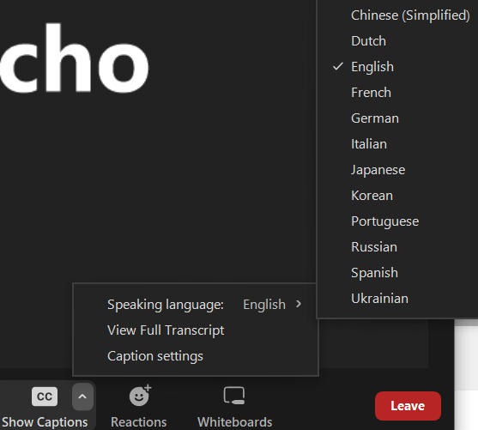
Activity #2: Showcase of Communication Tools features
How to view live transcription?
Join a meeting in Zoom.
Click the Show Captions button
Click the upward arrow character and select Speaking language to select your caption/transcript language
Note: To disable auto-transcription, click the Hide Captions button

Slide 22
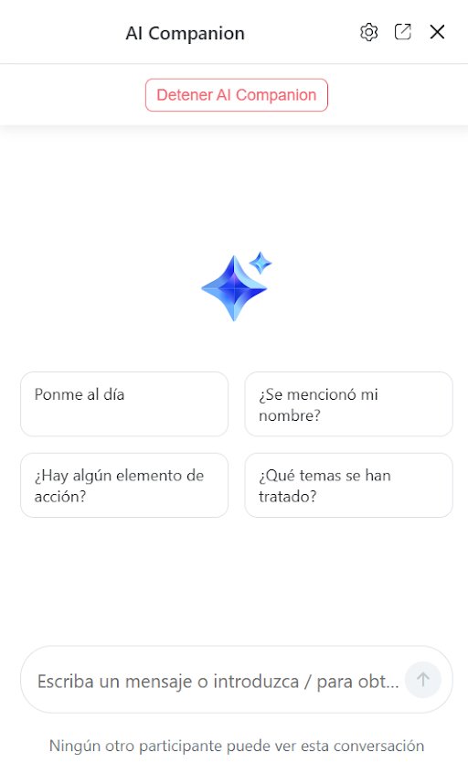
Activity #2: Showcase of Communication Tools features
What is an AI Companion?
Real-Time Assistance – transcribes, summarizes, and tracks action points.
Boosts Productivity – answers questions and helps with tasks.
Seamless Integration – enhances meetings without disruption.

Slide 23
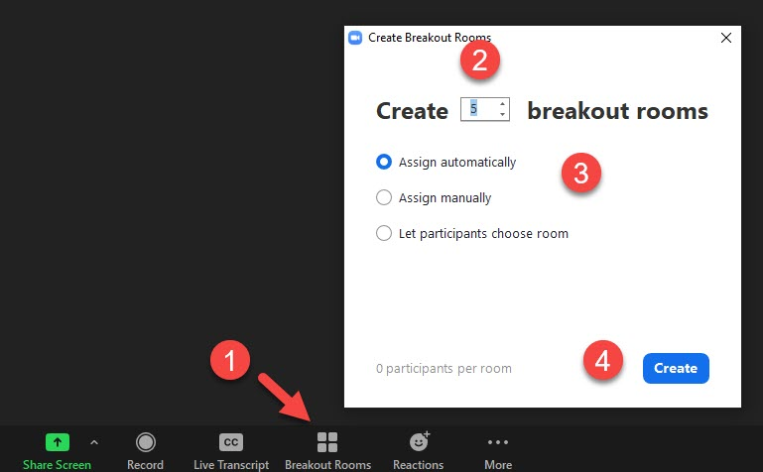
Activity #2: Showcase of Communication Tools features
How to create Breakout Rooms?
During the meeting select Breakout Rooms.
Enter the number of rooms you want to create.
Choose the method for assigning participants: Automatically, Manually.
Select Create.

Slide 24
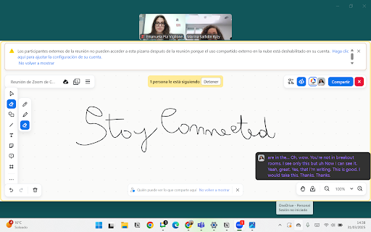
Activity #2: Showcase of Communication Tools features
How to use the Whiteboard?
Start a meeting from the Zoom
On the in-meeting controls, click the Whiteboards button.
Click New Whiteboard.

Slide 25

Topic 2: Tools for Hybrid Collaboration, Communication and Task Management
Project Management Tools: Workflow Automation
We are going to focus on...
ASANA
It is a comprehensive project management tool designed to help teams organize, track, and manage their work efficiently. It supports both individual task management and team collaboration, making it ideal for hybrid work environments.

Slide 26

Activity #3: Showcase of Task Management Tools features
ASANA
0h:30m
Activity Objective
This activity demonstrates the key features of Asana, focusing on how it supports management and task organization in hybrid teams, balancing both synchronous and asynchronous workflows.
Activity Outline
The facilitator provides a live walkthrough of Asana, demonstrating how to organize tasks by creating, assigning, and prioritizing them effectively. Participants will learn how to set up teams and manage members for project-specific collaboration

Slide 27
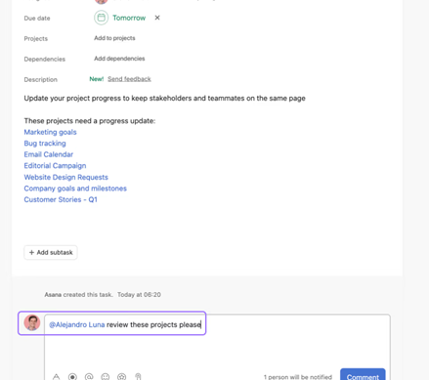
Activity #3: Showcase of Task Management Tools features
Organizing tasks
Tasks and subtasks can be added with its due date
Unscheduled tasks can also be added
Timeline of each task develop by each member

Slide 28

Activity #3: Showcase of Task Management Tools features
Creation of teams
It allows to create a team with the members of your choice
Share a project and work in real time
You can join and request different teams by searching on the browser
There is a common overview with a calendar and messages.

Slide 29

Activity #3: Showcase of Task Management Tools features
Task Management
Use of calendar to keep track of important project dates
Board view option, to check progress of open tasks
Keep track of who is developing each project and the members different tasks
Developing different sections and categories, to manage in a more efficient manner the priorities and the development of different categories

Slide 30
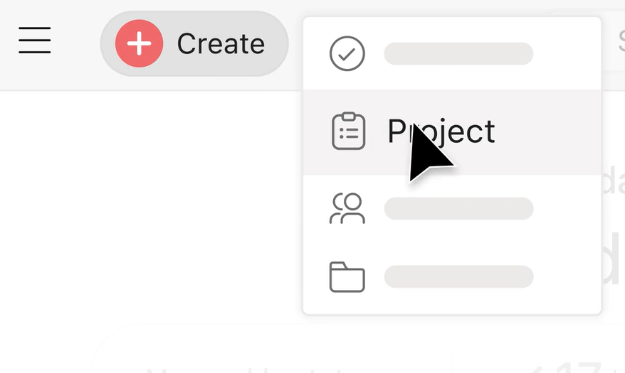
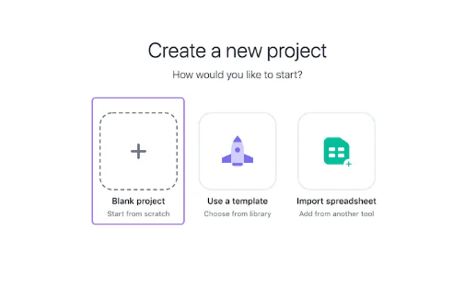
Activity #3: Showcase of Task Management Tools features
How to set up new project with ASANA AI?
Click the Quick add button
Select Project
A new screen will present you with 3 options: create a Blank project, Use a template, or Import a spreadsheet.
Click Blank project to start from scratch.

Slide 31
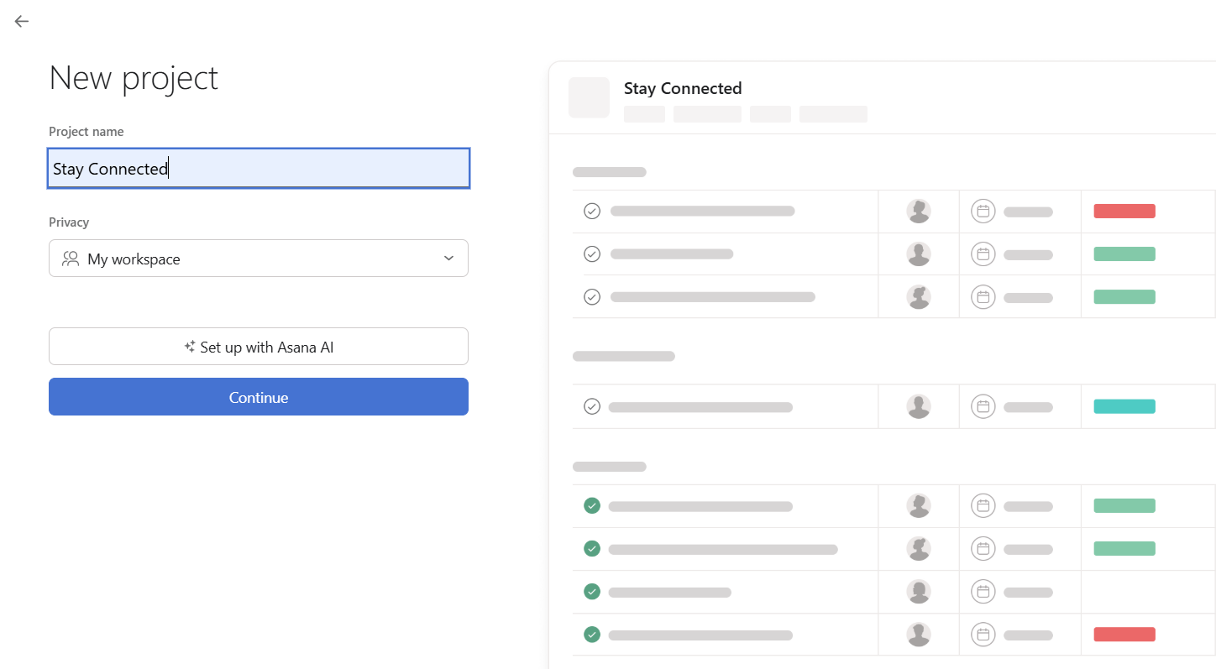
Activity #3: Showcase of Task Management Tools features
How to set up new project with ASANA AI?
Write the project name
Click Set up with ASANA AI

Slide 32
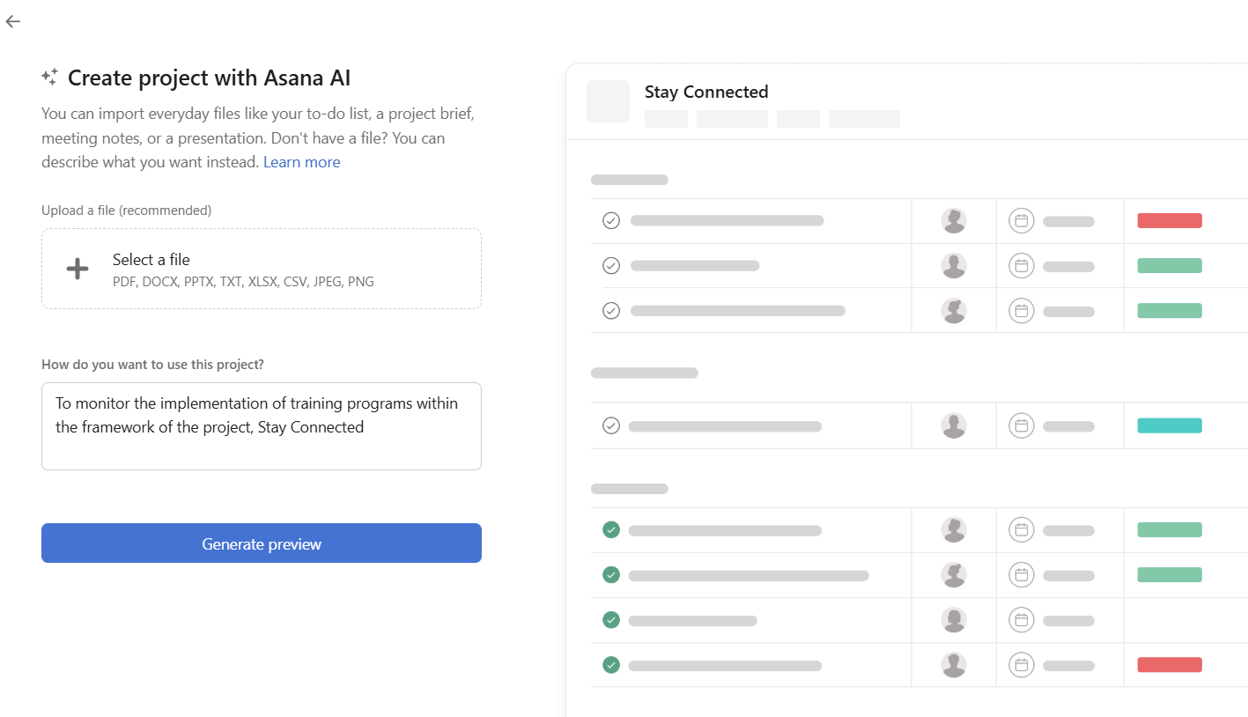
Activity #3: Showcase of Task Management Tools features
How to set up new project with ASANA AI?
Describe how do you want use this project
Click Generate preview

Slide 33
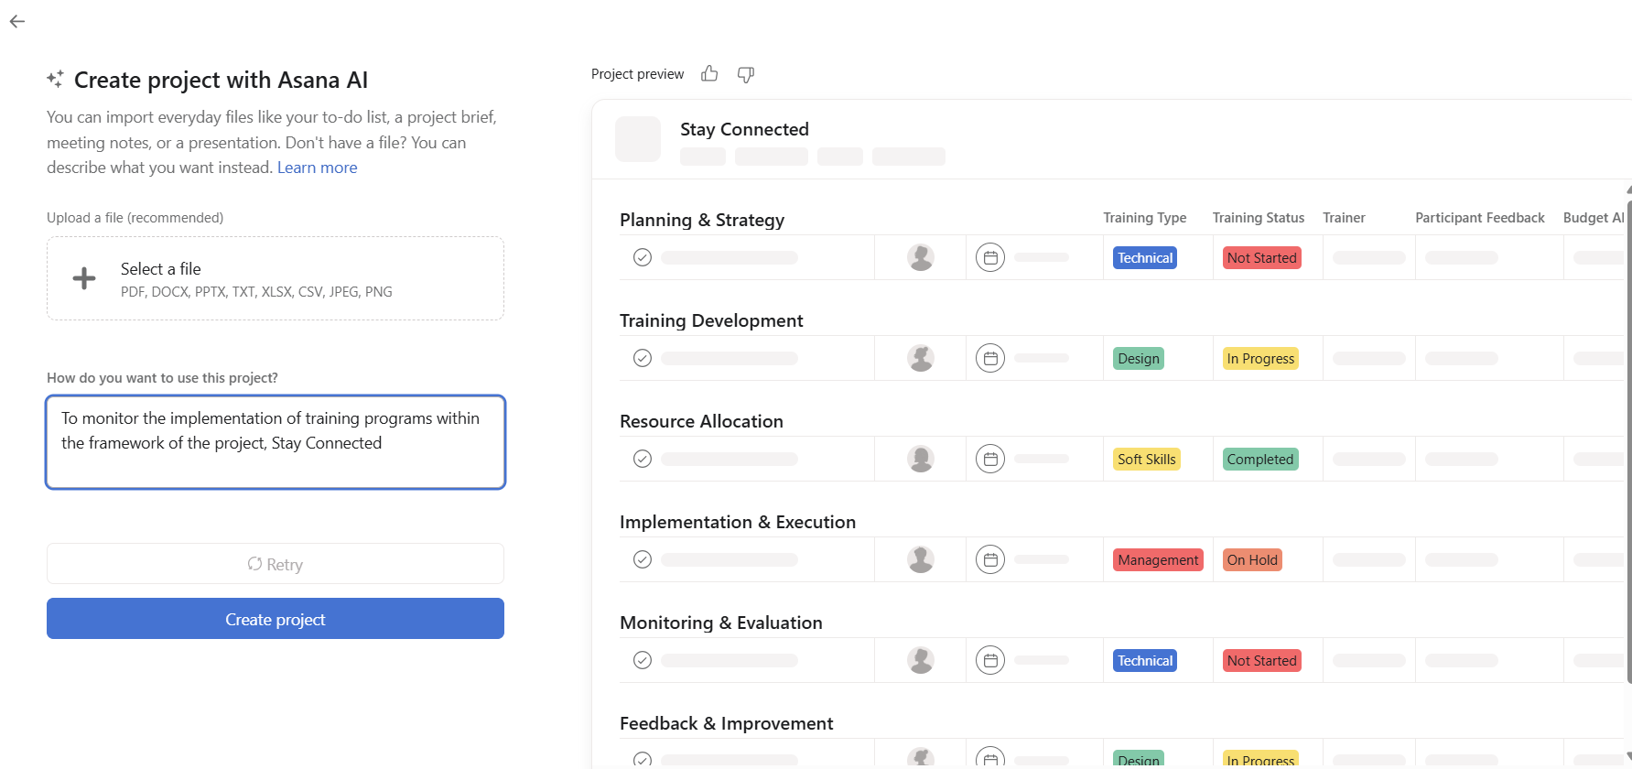
Activity #3: Showcase of Task Management Tools features
How to set up new project with ASANA AI?
Click Create project
Use the generated project template
The template can be edited as needed

Slide 34
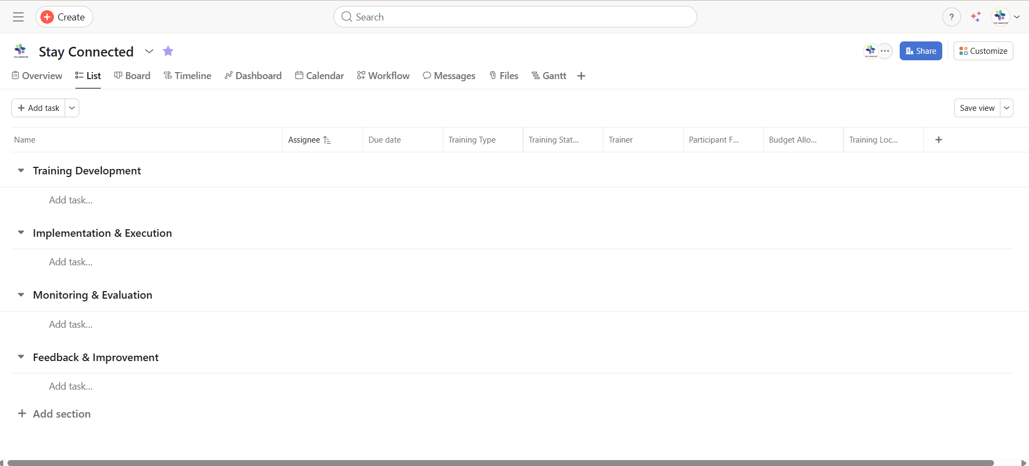
Activity #3: Showcase of Task Management Tools features
Template generated by ASANA AI

Slide 35
Topic 3
Balancing Technology Use and Avoiding Burnout
Notes:
DELETE ALL NOTES AT THE END
- include LU number and title

Slide 36
Topic 3: Balancing Technology Use and Avoiding Burnout
Importance of balancing technology
It is an useful tool for developing any kind of work
Essential to use it in a responsible manner
When used incorrectly it affects the company in a negative way
It can increase the productivity and performance of the employees

Slide 37
Topic 3: Balancing Technology Use and Avoiding Burnout
Burnout in hybrid and digital work
Blurry boundaries between personal and professional life
Constant connectivity and pressure to be “always available”
High workloads without sufficient support or rest
Lack of control or clarity over tasks and expectations

Slide 38

Topic 3: Balancing Technology Use and Avoiding Burnout
How can we avoid burnout?
By understanding what it is and its causes
Encouraging healthy work habits
Promote team collaboration and team building
Resources and practices to reduce stress

Slide 39

Topic 3: Balancing Technology Use and Avoiding Burnout
1iout
By understanding what it is and its causes
It is the state of complete mental, physical and emotional exhaustion mainly caused by long working hours.
To avoid this is important to set boundaries such as setting a clear schedule and breaks.

Slide 40

Topic 3: Balancing Technology Use and Avoiding Burnout
4.Balancing technology use and avoiding burnout
2t
Encouraging healthy work habits
How?
setting boundaries such as setting a clear schedule and breaks.

Slide 41

Topic 3: Balancing Technology Use and Avoiding Burnout
3
Promote team collaboration and team building
How?
Developing team activities
Getting to know the employees
Prioritizing social interaction, even in digital settings

Slide 42

Topic 3: Balancing Technology Use and Avoiding Burnout
4
Resources and practices to reduce stress
How?
Providing support to the employees, with clear hybrid work management policies
Provide guidance to the employees, on how managing their ‘time off’

Slide 43
Activity #4: The Happiest Team Tech Balance Challenge
Activity Objective
This activity’ goal is for participants to reflect on their tech habits and burnout signs, then create actionable strategies to balance technology use and avoid burnout.
Activity Outline
Participants will work in groups to create a "Happiest Team" board with tech balance strategies. Each team will share their commitments, fostering collaboration and accountability.

Slide 44
Activity #4: The Happiest Team Tech Balance Challenge
0h:30m
Team Reflection
What is one tech habit you would like to change or improve?
(e.g., reducing screen time, taking more breaks, not using social media before bed)
What is one activity or habit you will incorporate into your daily routine to help balance your tech use?
(e.g., going for a walk, practicing mindfulness, setting screen time limits)

Slide 45
Activity #4: The Happiest Team Tech Balance Challenge
0h:15m
Create the "Happiest Team" Board
The Team Name: eg. «The Happiest Team»
The Team's Commitments: A list of tech balance and burnout prevention strategies the group agreed on.
Share and Commit

Slide 46
Activity #4: The Happiest Team Tech Balance Challenge
Additional Resources
Author(s) | Title | Source / Publisher | Date | Link
Bloom, N., Liang, J., Roberts, J., & Ying, Z. J. | Does working from home work? Evidence from a Chinese experiment | National Bureau of Economic Research (NBER) | 2013 | https://www.nber.org/papers/w18871
Gratton, L. | How to do hybrid right | Harvard Business Review | 2023 | https://hbr.org/2021/05/how-to-do-hybrid-right
Heinze, C. | Best practices to build a sustainable hybrid work model | Tech Target | Sep 13, 2022 | https://www.techtarget.com/searchhrsoftware/tip/Best-practices-to-build-a-sustainable-hybrid-work-model
Choudhury, P., Khanna, T., Makridis, C. A., & Schirmann, K. | Is Hybrid Work the Best of Both Worlds? Evidence from a Field Experiment | Harvard Business School Working Paper No. 22-063 | Mar 2022 | https://www.hbs.edu/faculty/Pages/item.aspx?num=58284
Martin, J. | Home Working Hours, Rewards, and Opportunities in the UK: 2011 to 2020 | Office for National Statistics | 2021 | https://www.ons.gov.uk/.../2021-04-19
McKinsey & Company | Employers are ready to get back to significant in-person presence. Employees aren’t. | McKinsey & Company | Oct 2021 | https://www.mckinsey.com/capabilities/people-and-organizational-performance/our-insights/its-time-for-leaders-to-get-real-about-hybrid
McLaren, S. | 4 Best Practices for Building a Successful Hybrid Work Culture | Linkedin Talent Blog | Jul 22, 2021 | https://www.linkedin.com/business/talent/blog/talent-management/best-practices-for-successful-hybrid-work-culture

Slide 47


Thank You!

Slide 48








Funded by the European Union. Views and opinions expressed are however those of the author(s) only and do not necessarily reflect those of the European Union or the European Education and Culture Executive Agency (EACEA). Neither the European Union nor EACEA can be held responsible for them. Project Number: 2023-1-BG01-KA220-VET-000153460

