Slide 1

Training programme for HR professionals and Managers
Module 1
Understanding Hybrid Work & Practices
Notes:
DELETE ALL NOTES AT THE END
use 1 PPT per learning unit
keep between 20-25 slides per learning unit
each module/learning unit/section must be similar in length, have similar density and amount of content
each module has a total of 10 hours

Slide 2
Module aim and outline
Module 1 aims to welcome the trainees to the training event and introduce them to the relevant terminology, explaining the key variations and characteristics of the flexible workspace and hybrid workplace emphasizing the importance of flexibility. Also, the raise of understanding of the pros and challenges of the hybrid workplace and presents the various hybrid work models and office layouts in a hybrid workplace which are essential for efficient hybrid work arrangements.
This module is divided into the following topics:
Trainees Welcome with Ice-Breaking Activity
Topic 1 Defining Hybrid Work, also Pros and Cons
Topic 2 Become Familiar with Various Hybrid Work Model
Topic 3 Unlocking Flexibility in the Hybrid Workplace
Notes:
DELETE ALL NOTES AT THE END
- keep the same presentation style in all PPT’s

Slide 3

Icebreaker Activity: “ Check-in With Two Words for Yourself
STEP 1
In just two words, “describe how you are feeling right and what you are looking forward to during this event”
Virtual participants can type their two word into the chat
STEP 2
Now share with the group: “What is one thing you hope to gain or contribute during today’s event?”
In-person attendees: write on sticky notes or discuss briefly
Virtual participants: use the chat.
0h:10m

Slide 4

Topic 1 Defining Hybrid Work & Pros and Cons
Notes:
DELETE ALL NOTES AT THE END
- include LU number and title

Slide 5
Topic 1: Defining Hybrid Work
A new work framework where employees have the flexibility to work from a location physical apart from their employer (Peprah, 2023). Other related terms for hybrid work are:
Telework and ICT-based mobile work (TICTM)
Remote work
Home-based working
Telecommuting
Virtual working
A new term: Activity-based flexible offices (A-FO) referring to a working environment where people can do the job anytime and anywhere using digital devices without restrictions on time or space (Jang et al, 2021, p.87)
Notes:
DELETE ALL NOTES AT THE END
The hybrid workplace is now known as a workplace model which combines remote working with on-site or physical office working. In simple terms, employees have the flexibility to work from anywhere of their choosing during the remote working schedule (Peprah, 2022). Although the term “hybrid workplace” may sound new, other terms have also been used interchangeably and refer to the context of an employee working from a location physically apart from their employer, while using telecommunication technology. These are telework, remote work, home-based working, telecommuting, and virtual working.
JinWon Jang, Yong Gi Park, Seong Il Hur, and Yong Jun An

Slide 6
Topic 1: Defining Hybrid Work & Pros and Cons
60% of remote employees, from 8090 US companies, reported that prefer hybrid work options (Wigert et al., 2022).
The dominant business model is hybrid for 49% of 10,646 knowledge workers around the globe (Future Forum, 2022),
54% of 1421 Australian knowledge workers are following some type of hybrid work model, too, and
56% report this as an ideal work arrangement for them (Hopkins, & Bardoel, 2022).
Notes:
The way we work has changed rapidly over the last couple of years. As the working world slowly returns to its new form, it is apparent that more and more people are leaning towards hybrid models as the future of work. Many surveys have shown that the majority of employees do not want to return to the office full-time:
Wigert, B.; Agrawal, S. Returning to the Office: The Current, Preferred and Future State of RemoteWork. Washington DC. 2022.
Available online: https://www.gallup.com/workplace/397751/returning-office-current-preferred-future-state-remote-work
.aspx (accessed on 31 August 2022).
Future Forum. Summer 2022 Future Forum Pulse; Future Forum: Phnom Penh, Cambodia, 2022.
Hopkins, J.; Bardoel, A. Flexibility Makes Us Happier, with 3 Clear Trends Emerging in Post-Pandemic Hybrid Work, The
Conversation. 2022. Available online: https://theconversation.com/flexibility-makes-us-happier-with-3-clear-trends-emergi
ng-in-post-pandemic-hybrid-work-180310 (accessed on 4 April 2022).

Slide 7
Topic 1: Pros and Cons of Hybrid Work
Recent surveys on employees have shown…
29% say their productivity is much better working from home and 24% say it’s a little better.
39% of people want to work from home 3-4 days a week.
39% say the creativity of their work is better when working from home.
49% say their mental health is better when working from home.
59% say their work-life balance is better when working from home.
Only 9% of remote workers say they want to work in an office all the time
Source: LEADERSHIP IQ (2020)
Notes:
The way we work has changed rapidly over the last couple of years. As the working world slowly returns to its new form, it is apparent that more and more people are leaning towards hybrid models as the future of work. Many surveys have shown that the majority of employees do not want to return to the office full-time:

Slide 8
Topic 1: The Flexible Office Space in the Hybrid Workplace
The remote work policies have presented various variations to the physical layout of the office in a hybrid workplace, including:
Open office
Co-working office
Activity-based office
Satellite office
Home office
Remote locations
Barath & Schmidt, (2022)
Notes:
The office environment has always been seen as a main driver of organizational strategy, culture and performance
The implementation of remote work (work from home, home office) policies has induced a massive shift of employees from the office space to the home environment (Xiao et al., 2021)
This presents a challenge to the physical layout of the office as a hybrid workplace.
Its characteristic features are openness and flexibility (Danielsson, & Theorell, 2018)
The flexible office space, also known as flexi-space, includes the fundamental features
of the traditional office, such as desks, chairs, phones and computers. However, it provides.
dynamic environment that meets the needs of both employees and employers (Barath & Schmidt, 2022)
According to Barath & Schmidt, (2022) there are the following variations of flexible office space:
The open office is an office configuration with minimum or no interior boundaries,
such as walls or partitions between employees. The idea is to facilitate communication and idea flow in organizations.
The co-working office is where a group of different employees, usually employed
by different employers or self-employed, use a common, shared workplace. Such spaces
provide the opportunity for remote workers to work in a more stimulating environment
rather than home.
Building virtual co-working and digital co-working mechanisms that keep the community together can help employees feel more secure and minimize the adverse impact of the home office
The activity-based office allows employees to work on various activities, whether alone
or in collaboration with others, while changing multiple types of flexible work settings
during the day with no fixed desk in the workplace
The satellite office is a type of remote work environment where an employee works in
a center established by the employer outside the employer’s premises, e.g., at the client’s
place in their location or region.
The home office became an important part of the pandemic and gives employees the flexibility to arrange their work time and environment.
Other remote locations (offices) are alternative workspaces or locations that are open
to the public, such as cafés, libraries, vacation homes, streets, parks, car parks or railway
stations. This form of office is associated only with certain jobs and is usually tied to a good
quality Internet connection

Slide 9


Activity #1: Pros and Cons of the Hybrid Workplace: Time to Offer Your Views
Learning new knowledge
The aim of this activity is to raise awareness of the positive and negative aspects of hybrid work arrangements
After the completion of this activity, you will be able to:
Articulate the pros and cons of the hybrid workplace
Recognize how the hybrid work model affects and impacts different organizational and individual aspects of performance and behavior

Slide 10
Activity #1: Pros and Cons of the Hybrid Workplace: Share Your Views and Experience
STEP 1
Prepare a Mentimeter quiz with the following questions to collect the views of the trainees. Motivate the trainees to use their cell phones and connect with the following link and type keywords
From your personal experience..
Do you think hybrid work is sustainable for your role in long-term? Why or why not?
What's something that has changed about your job since you went remote that you think is a POSITIVE CHANGE? (or would change)
What's something that has changed about your job since you went remote that you think is a NEGATIVE CHANGE? (or would change)
How do you think the hybrid model has influenced TEAM DYNAMICS or workplace CULTURE? (or would change)
What is the ONE CHANGE you would suggest to improve the hybrid workplace model for employees like you?
You have 5 minutes!
0h:15 m

Slide 11
Activity #1: Pros and Cons of the Hybrid Workplace: Share Your Views and Experience
STEP 2
Let's see the results!
And find out together most common key pros and cons, also, major changes and key influences on the group dynamics of the workplace culture
0h:15 m

Slide 12
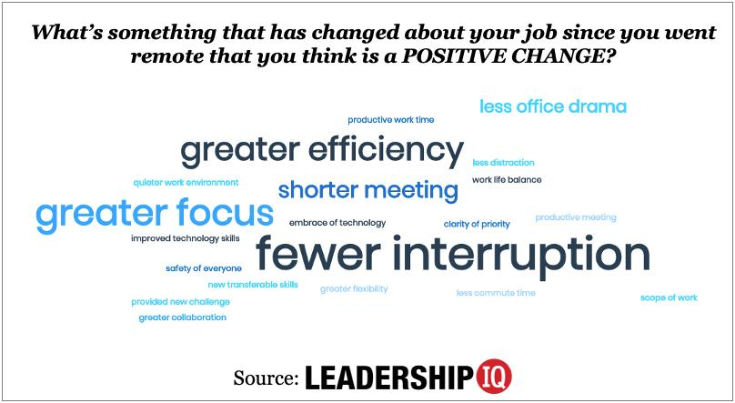
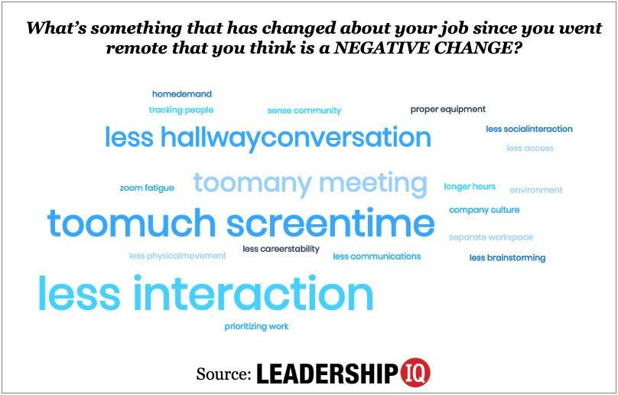
Topic 2: Pros and Cons of Hybrid Work Based on the Literature
Source: LEADERSHIP IQ (2020)

Slide 13
Topic 2: Pros and Cons of Hybrid Workplace based on Literature
Advantages | Challenges
Cost saving & Time saving | Physical Distance
Lower absenteeism rate | Communication issues
Better work-life balance | More complex management
Flexibility and increased family time | Complex requiting criteria
Higher competitive advantage | Social isolation of workers/teamwork affected
Access to a wider pool of talents | Cross-network communication
Increased productivity & efficiency | Less sense of inclusivity
Employees’ self-confidence increased | Less professional interaction & engagement
Digitalisation of work | Reduced employee visibility
Ziegler & Lutger (2023) & Lenka (2021)
Notes:
DELETE ALL NOTES AT THE END
- include LU number and title

Slide 14
Topic 2
Become Familiar with Various Hybrid Work Models
Notes:
DELETE ALL NOTES AT THE END
- include LU number and title

Slide 15
Topic 2.1. Introducing the Basic Hybrid Work Model
Defining the Hybrid Work Model
“Hybrid work model underlines the combination of remote work and physical presence in the office” (Lenka, 2021)
(Hopkins & Bardoel, 2023)
Remote only
or
Remote First
Office First (fixed days/flexible)
Fixed hybrid
Full Flex Schedule
Notes:
https://apploye.com/blog/hybrid-working-model-examples/ ΚΑΛΟ ΕΧΕΙ ΠΑΡΑΔΕΙΓΜΑΤΑ
“The practice of alternating between different working environments, such as from home and in an office” (dictionary)
Hybrid work models would reduce commuting and increase workers’ flexibility and sense of autonomy (Caligiuri et al., 2020).
means something to people.” (A1)
Full flex—workers choose the location where they work and when
Office First (2 options)
Office frequency and days both fixed
Fixed office frequency, but attendance days flexible
1 Flexible Hybrid Model--Employees have the flexibility to choose when and where they work, within certain guidelines or core hours.
Description: Employees choose when to work remotely or in the office based on their tasks and personal preferences.
Advantages: High flexibility for employees, fostering autonomy and work-life balance.
Challenges: Can lead to scheduling conflicts and inconsistent office attendance.
2. Fixed Hybrid Model--Set schedule of in-office and remote work days.
Description: Specific days are designated for remote work and in-office work (e.g., remote on Mondays and Fridays, in-office on other days).
Advantages: Predictable schedules for employees and managers, simplifying coordination.
Challenges: Limited flexibility may not accommodate individual preferences or needs.
3. Office-First Hybrid Model---Employees predominantly work in the office but have the option to work remotely occasionally. (fixed days a week in the office
Description: Employees are expected to work primarily from the office but have the option to work remotely on occasion.
Advantages: Maintains a strong in-office culture and collaboration.
Challenges: Offers limited remote flexibility, potentially alienating employees who prefer remote work.
4. Remote-First Hybrid Model ---Employees predominantly work remotely, with occasional in-person meetings or gatherings.
Description: Employees are encouraged to work remotely by default but have access to office space for collaboration or personal preference.
Advantages: Provides flexibility while supporting in-person collaboration when needed.
Challenges: May lead to underutilized office space and challenges in maintaining team cohesion.
5. Team-Based Hybrid Model
Description: Teams or departments decide their hybrid arrangements collectively, tailoring schedules to their specific needs.
Advantages: Customized solutions for different team dynamics and functions.
Challenges: Can create inconsistencies across the organization and complicate cross-departmental collaboration.
Remote first model- Organizations like Quora and Dropbox are following the remote first model. In this model most of the employees plus the leadership teamwould be generally working remotely but if there is an urgent requirement for physical presence may be one or two days in a month that can be done by fewemployees. The office space would be physically present and if anyone wants to utilize it for official use can be done but not frequently but whenever there is a requirement.
Office Occasional- Many organizations still now have not accepted the remote work model. They still feel that employee’s physical presence in the office twice or thrice in a week is necessary for the organization.
Office first, remote allowed: This model uses the combination of remote first and office occasional. In this model the organization mostly works offline and
occasionally remote working. Most of the employees including the leadership team come to office regularly and those who have opted for remote work are kept in loop and important discussions are briefed to them

Slide 16
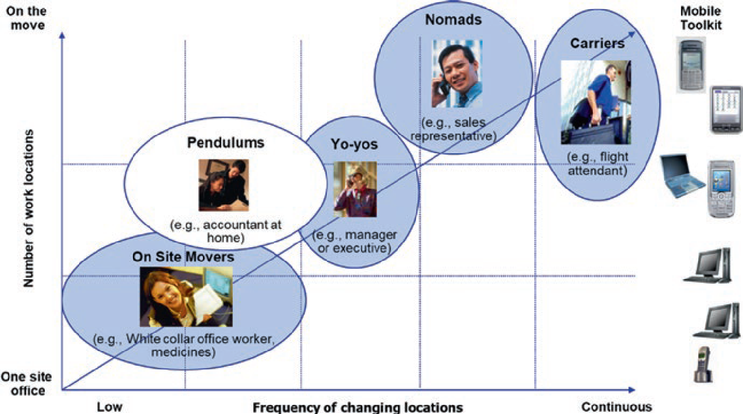
Topic 2.1. Defining Hybrid Work
A Garden of Individual Mobility
Fig. 2 Types of physically mobile employees (Vartiainen & Andriessen, 2006, p. 272)

Slide 17
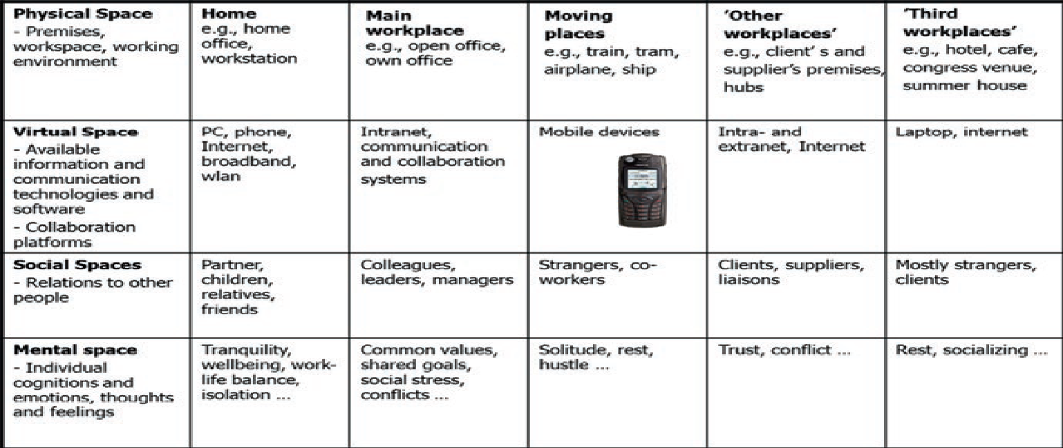
Topic 2.1.Types of workspaces in mobile multilocational work
(Vartiainen et al., 2007, p. 31)

Slide 18
Activity #2: Identifying the hybrid work model
Learning new knowledge
The aim of this activity is to recognize the different hybrid work models by analysing three specific case studies of organizations
After the completion of this activity, you will be able to:
Identify the hybrid work model of an organization
Distinguish the key factors defining the hybrid work model
Differentiate the various physically mobile employees

Slide 19
Case Study #1: Identify the Hybrid Model
In April 2023, Google implemented a hybrid work model that blends in-office and remote work to provide employees with flexibility while preserving collaboration and connection. Most employees follow a schedule of three days in the office and two days working remotely, wherever they feel most productive.
To support this model, Google introduced initiatives like "work-from-anywhere" weeks, designated "focus time," and "reset days" to enhance employee flexibility and well-being. These efforts aim to empower employees while maintaining a strong company culture.Google's hybrid approach reflects a broader trend in the tech industry, where companies strive to balance employee preferences with organizational goals.
Students are invited to analyze the impact of such models on employee satisfaction, productivity, and team dynamics in a rapidly evolving workplace landscape.
Topics for class reflection
Define the above hybrid model
What is the impact of this model on employee satisfaction and productivity?
How suitable is this model for your organization?
Source for the Case Study
0h:15 m
Notes:
has declared regarding following the Unique Hybrid Model

Slide 20
Case Study #2: Identify the Hybrid Model
Starting from October 2020, Microsoft’s Hybrid work model consists of more of 50% employees working remote and of less time in office. The permission from management is not required. If one employee wants to work 60% remote and 40% in office, then permission from management is necessary. Those employees who permanently want to work remotely they must take permission from the management. These employees won’t have dedicated place to sit when they would come to office when there would be a requirement, but some place would be given to them. Microsoft has also decided to take care of the financial aspect of employee’s remote work expenditure.
Topics for class reflection
Define the above hybrid model
What is the impact of this model on employee satisfaction and productivity?
How suitable is this model for your organization?
Source for the Case Study
0h:15 m
Notes:
has declared regarding following the Unique Hybrid Model

Slide 21
Activity #2: Identifying the hybrid work model
Visit the following link for more case studies on various hybrid models
10 Hybrid Companies Examples with Working Models in 2025
Source for the Case Study
0h:15 m
Notes:
has declared regarding following the Unique Hybrid Model

Slide 22
Topic 2: More on How to Select the Right Hybrid Work Model
Is competitive advantage feasible with the hybrid model?
Does the strategy depend on highly collaborative teams?
How feasible is to keep under control the communication nodes?
What is the opinion of the employees?
How the tasks will be defined in the hybrid model (office/remote hours) and KPIs?
How monitoring will be organized in the hybrid workplace?
(Pontiggia & Gatti, 2021)

Slide 23
Topic 3 Unlocking flexibility in the hybrid workplace
Notes:
DELETE ALL NOTES AT THE END
- include LU number and title

Slide 24
Forms of Flexibility in the Hybrid Workplace
Organizational Flexibility: Customizable schedules for employees in terms of time, location, tasks and team-work.
Social Flexibility: The challenge to harmonize face-to-face with virtual synchronous and asynchronous contact.
Individual Flexibility: The autonomy of employees to customize work schedules, task-related preference and work methods.
0h: 5 m

Slide 25
Organizational Flexibility in the Hybrid Workplace
In terms of flexible time schedules (when, how often, low long)
Time
In terms of location (then need to work from home or other working location
Location
In terms of the organization (flexibility for job rotation, role expansion, project-based work, temporary teams or virtual teams, or multi-team systems)
Orgaization
In terms of work relations (work on demand, part-time, labour leasing contracts, outsourced workforces, pay-per-piece basis)
Work Relations
0h: 5 m

Slide 26
Social Flexibility in the Hybrid Workplace
Stable teams turn often to dynamic teams
Team membership may change often
Lack of clear social boundaries

Slide 27
Individual Flexibility in the Hybrid Workplace
Freedom
Independence
Discretion

Slide 28
Activity #3: Group Exploration on Key Characteristics of the Hybrid Workplace
The aim of this activity is to recognize the critical role of flexibility in the hybrid work models by focusing on the individual, social and organizational flexibility
Learning new knowledge
After the completion of this activity, you will be able to:
Identify and articulate the fundamental characteristics of the hybrid workplace
Recognize the key challenges that might arise
Differentiate the various types of flexibility in the hybrid workplace
0h: 60 m
Notes:
Nonetheless, this presents a significant challenge for organisations as they are trying to balance productivity, creativity, physical safety, and employee preferences. The hybrid work model can be daunting and unfamiliar territory for leaders.
As the old way of work is fading into the background, leaders need to adapt their way of managing, quickly. One of the biggest challenges of managing a hybrid workforce is maintaining corporate culture and creating uniformity between the remote and in-office experience and expectations.
The good news is that even though leaders are concerned with the hybrid way of work, organisational initiatives such as feedback, training and day-to-day operations, continue to progress in a remote work environment. The most critical lesson has been the importance of soft skills leaders need to manage their employees effectively even while working remotely. Leadership traits that will predict success include trust, empathy, inclusivity and communication. Whether they are leading a small team or a large enterprise.

Slide 29
Activity #3: Group Exploration on Balancing Flexibility with Different Scenarios
STEP 1: Introduction
Have a look on this spectrum with one end labeled "Full Structure" and the other "Complete Flexibility."
Where do you think your organizations currently stands on supporting individual flexibility?
Take your position and explain why you have chosen this spot.
STEP 2: Scenario-Based Discussions
Please divide into small groups of 3-5. Each group should select a scenario that represents a challenge related to individual flexibility.
Suggested Scenarios:
(A) Two employees request to work fully remote, but their role traditionally requires in-office collaboration
(B) Team Members struggles with scheduling conflicts due to varied work hours or hour zones
(C ) Manager finds it hard to assess performance in a flexible environment
Notes:
What principles guide your decision?How do you ensure fairness and inclusivity?What tools or policies could support this situation?
prepare a hands-on activity in a format of step-by-step
use work-based learning (WBL) methodologies
use examples and best practices from real life situations as much as possible
activity title should be action-oriented and fit in one line
indicate time to develop this activity
this activity should be assigned to f2f training

Slide 30
Activity #3: Group Exploration on Balancing Flexibility with Different Scenarios
STEP 3: Presentation
Each group role-play your proposed solution
After the role-plays, please provide feedback or suggests alternative approaches (for the audience
STEP 4: Takeaway reflection
"What is the one most important action you will implement to support individual flexibility in your workplace?“
Let’s capture our responses in a shared document for collective inspiration
0h:60m
Notes:
Capture responses in a shared document or whiteboard for collective inspiration
prepare a hands-on activity in a format of step-by-step
use work-based learning (WBL) methodologies
use examples and best practices from real life situations as much as possible
activity title should be action-oriented and fit in one line
indicate time to develop this activity
this activity should be assigned to f2f training

Slide 31
Wrap-Up and Reflection
Short Assessment activity (quiz)
Reflect on the modules’ content and activities

Slide 32
Key Sources
Jang, J., Park, Y., Hur, S., & An, Y.J. (2021). Flexible Office Characteristics on the Employees’ Innovative Behavioral Intention. Chapter in Edits by Lee R. & Kim J. B. “Software Engineering, Artificial Intelligence, Networking and Parallel/Distributed Computing. Computational Intelligence 951 by Springer
Hopkins, J.; Bardoel, A. The Future Is Hybrid: How Organisations Are Designing and Supporting
Sustainable Hybrid Work Models in Post-Pandemic Australia. Sustainability 2023, 15, 3086. https://
doi.org/10.3390/su15043086
Barath, M.; Schmidt, D.A. Offices after the COVID-19 pandemic and changes in perception of flexible office space. Sustainability, 2022, 14, 11158
Links
10 Hybrid Companies Examples with Working Models in 2025

Slide 33
University of Patras Greece
www.upatras.gr dpapad@upatras.gr
Notes:
DELETE ALL NOTES AT THE END
- complete contente developer partner information

Slide 34









Funded by the European Union. Views and opinions expressed are however those of the author(s) only and do not necessarily reflect those of the European Union or the European Education and Culture Executive Agency (EACEA). Neither the European Union nor EACEA can be held responsible for them. Project Number: 2023-1-BG01-KA220-VET-000153460

