Slide 1

Training Package for HR Professionals and Managers
Module 4
How to Facilitate Social Connectedness in Hybrid Workplaces

Slide 2
Module aim and outline
This module equips HR professionals and managers with the insights, strategies, and practical tools they need to create a supportive, inclusive culture regardless of physical location. By the end of this module, participants will understand the importance of social connection in hybrid workplaces and be prepared to implement initiatives that boost morale, collaboration, and overall well-being.
This module is divided into the following topics:
Understanding social connectedness
Challenges in hybrid and remote workplaces
Strategies to enhance social connectedness
Inclusivity and empathy as cornerstones of connection
Creating your Social Connectedness Blueprint

Slide 3

Icebreaker

Slide 4

Icebreaker
Interpersonal connections. What are they, and why are they important? Why might they be especially important in the workplace?
In pairs or small groups, take five minutes and discuss a workplace connection that has positively impacted you. How has this connection enhanced your experience at work?
After the five minutes has passed, we’ll come back together to chat about these connections and their value.
Photo by DS stories via Pexels

Slide 5
Topic 1 Understanding social connectedness

Slide 6
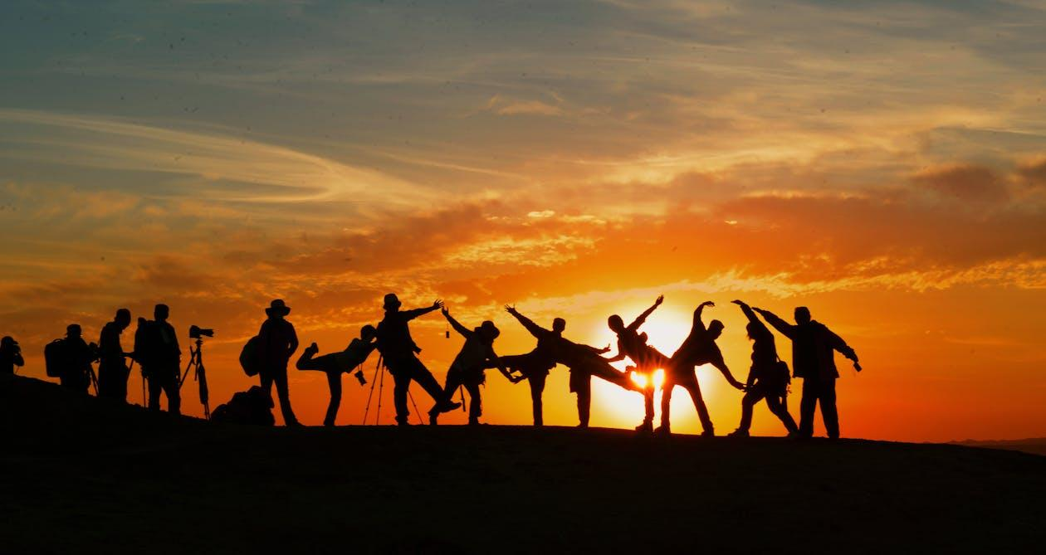
Understanding social connectedness
What is social connectedness?
Social connectedness can be defined as the experience of belonging to a social relationship or network (Lee & Robbins, 1995). It is a “basic psychological need, critical for well-being” (Zhao et al., 2022). As you likely uncovered during the Icebreaker, it contributes to a sense of belonging and support which enriches our daily lives.
What is the impact of social connectedness on hybrid and remote work?
When you think of social connectedness in the context of hybrid and remote work, thoughts of the exact inverse might immediately spring to mind. Many hybrid and remote workers report feelings of disconnectedness from their peers, which can have a negative impact on their wellbeing and morale.
Does connectedness contribute to productivity and engagement?
Contrary to the aforementioned negative impacts however, employees that feel a higher degree of social connectedness to their hybrid and remote workplaces and peers are generally more productive (O’Reilly, 2023).
Photo by Pixabay via Pexels

Slide 7
Understanding social connectedness
What are the different components of social connectedness? Per Holt-Lunstad (2018), this vital and enriching aspect of our day-to-day lives can effectively be measured using the following factors:
Structure: The number and variety of our relationships and the frequency of our interactions. This covers considerations like the size of our networks or our marital status.
Function: The utility provided by our relationships, such as the emotional support they provide us with.
Quality: The balance of positive versus negative aspects we experience in our interpersonal relationships, which can be determined by taking stock of our level of relationship satisfaction, any feelings of social exclusion (or inclusion) that we may be experiencing, etc.

Slide 8

Understanding social connectedness
In essence, social connectedness boils down to three major things: communication, trust, and belonging.
A high level of social connectedness is defined by regular and fulfilling communication with a circle of supportive peers that is predominantly positive and rewarding. Of course, negativity is bound to crop up in our interpersonal relationships throughout life - but it should ideally remain in the minority when compared with positive interactions.
Photo by Jopwell via Pexels

Slide 9


Understanding social connectedness, Activity: Show of Hands
The aim of this activity is to reflect on your team’s current state of connectedness.
Learning new knowledge
After the completion of this activity you will be better able to:
Understand the concept of social connectedness and its impact on employee wellbeing, engagement, and performance in a hybrid workplace.
Identify the unique challenges that affect social connectedness in hybrid environments.
Recognise the role of leadership and the wider organisation in developing an inclusive, connected workplace environment across physical and virtual spaces

Slide 10
Understanding social connectedness, Activity: Show of Hands
Show of Hands!
Who here would say that their workplace is well socially-connected?
If you raised your hand, do you currently have access to hybrid or remote working arrangements? How is social connectedness encouraged in this context?
If you did not raise your hand, do you currently have access to hybrid or remote working arrangements? What would you change about your workplace to make it better socially connected?
Reflection
How does your workplace’s current level of social connectedness impact your day-to-day life in terms of your wellbeing, your productivity at work, etc.?
Discussion
Based on the examples provided here today, what defining aspects of a socially well-connected workplace stand out to you in particular? Did any of the insights provided surprise you? Why / why not?

Slide 11
Understanding social connectedness
RESOURCES
Check out this useful infographic from the US Office of the Surgeon General, which details the “Three Vital Components of Social Connection”, available here.
Learn more!
Holt-Lunstad J. (2018) Why Social Relationships Are Important for Physical Health: A Systems Approach to Understanding and Modifying Risk and Protection. Annu Rev Psychol. 69, 437-458
Lee, R. M., & Robbins, S. B. (1995). Measuring belongingness: The Social Connectedness and the Social Assurance scales. Journal of Counseling Psychology, 42(2), 232–241. https://doi.org/10.1037/0022-0167.42.2.232
O’Reilly, M. (2023) Belonging in the era of remote and hybrid work, IBEC. Available at: https://www.ibec.ie/connect-and-learn/insights/insights/2023/11/28/belonging-in-the-era-of-remote-and-hybrid-work.

Slide 12
Topic 2 Challenges in hybrid and remote workplaces

Slide 13
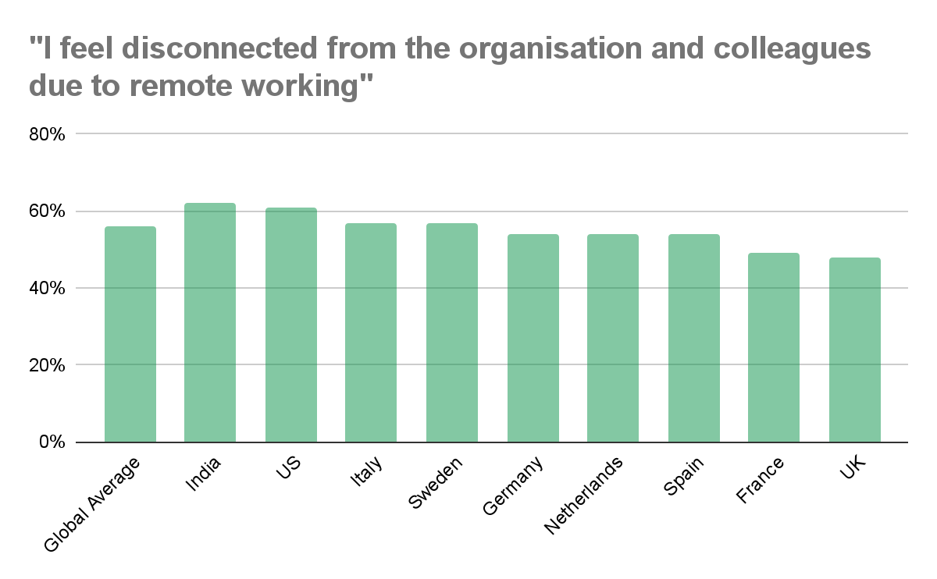
Challenges in hybrid and remote workplaces
Thus far, we have spoken about the concept of social connectedness in the workplace. Specifically, we have highlighted what this term means, as well as some of its most important components.
It should come as no surprise, then, that one major challenge in hybrid and remote workplaces is a feeling of disconnectedness. On the left, you will find the results of a “future of work” poll conducted by Crummenerl et al. Nearly half of all respondents who answered the survey indicated that they feel disconnected from their organisation and colleagues as a direct result of remote working.
This is likely a consequence of many factors, however it has been noted in similar studies that the relatively limited number of informal interactions (the “water cooler chats”, for example, so often taken for granted in a physical office environment) is a major barrier to social connectedness in the remote and hybrid workplace.
Source: Crummenerl, C. et al. (2020) The Future of Work: From remote to hybrid, capgemini.com. Available at: https://www.capgemini.com/wp-content/uploads/2020/12/Report-The-Future-of-Work.pdf

Slide 14

Challenges in hybrid and remote workplaces
Another challenge frequently cited by both employers and employees when it comes to the remote or hybrid workplace is a lack of trust and confidence between managers and their teams.
Some managers report a perception that tasks may not be completed to expected standards without them being physically present to supervise work. Some employees, for their part, attribute this type of monitoring to micromanagement, and are frustrated that they seemingly can not be trusted to do their jobs.
Both of these perspectives on the difficulties with trust and confidence in the hybrid workplace are completely valid and should be handled with respect and care. Ideally, a constructive conversation should happen at the earliest possible juncture where this topic is concerned; otherwise there is a risk of growing resentment within a team.
Photo by fauxels via Pexels.

Slide 15
Challenges in hybrid and remote workplaces
Writing for the Harvard Business Review, Martine Haas, who has been studying virtual teamwork for over 25 years, identifies five “C” challenges posed by the hybrid or remote workplace; communication, coordination, connection, creativity, and culture (Haas, 2022). We’ve provided a general overview of each of these types of challenges below.
Communication: Perhaps the most obvious challenge, these difficulties often arise in the hybrid and remote workplace because distance represents another complicating factor in our communication. Already, complex dynamics and barriers presented by authority, language, etc., can make communication difficult; a reality only exacerbated by distance. This is without speaking to the many logistical challenges under this topic, such as implementing organisation-wide remote connectivity.
Coordination: In the office environment, a minor adjustment or change of plans can be communicated easily by means of a short conversation in passing or a knock on a colleague’s door. Where coordination must happen remotely, it requires the mutual availability of both parties, and there may be a perception that some updates aren’t pressing enough to warrant an email or video call. As such, employees can sometimes fall out of the loop.
(Haas, 2022)

Slide 16
Challenges in hybrid and remote workplaces
Connection: We’ve previously discussed the importance of feeling connected to your workplace and colleagues. In a remote context, it can be challenging to initiate spontaneous informal communication that contributes to social connectedness; IE, “watercooler chats”, coffee breaks, etc. Furthermore, it can be really helpful in an office environment to have a mentor figure who can support us in our day-to-day work. While it is possible to recreate these dynamics in a hybrid or remote workplace, they can sometimes feel more like an obligation than an investment.
Creativity: Ideas are dynamic and can occur at any moment, often naturally arising from the flow of conversation. In remote and hybrid environments, where interactions generally occur according to a predetermined schedule, there can be fewer opportunities for a thirty second “elevator pitch” to happen off the cuff. Additionally, brainstorming is enhanced by the organic participation of peers, who can pick apart ideas and reinforce them with their own contributions. Where this becomes an assigned activity rather than a spontaneous discussion, creativity can be limited.
Culture: Culture is essentially the intangible atmosphere that is unique to an organisation. When a hybrid or remote workplace is more or less just a computer screen, it can be difficult to stamp a digital workplace with a company’s culture. This is particularly difficult during the onboarding process, as an organisation’s culture can be a fantastic selling point, as well as a way to better integrate new hires.
(Haas, 2022)

Slide 17
Challenges in hybrid and remote workplaces, Activity:
Brainstorming Solutions
The aim of this activity is to develop learners’ capacity to brainstorm creative solutions to challenges in hybrid and remote workplaces
Learning new knowledge
After the completion of this activity you will be more:
Empathetic towards hybrid employees' social and emotional needs
After the completion of this activity, you will be better equipped to:
Develop strategies to create and sustain meaningful connections among team members, regardless of their physical location
Design initiatives, events, and routines that encourage meaningful and impactful interaction within hybrid teams
Materials Required:
Paper, flipchart, sticky notes, etc.
Pens, markers, etc.

Slide 18
Challenges in hybrid and remote workplaces, Activity: Brainstorming Solutions
Challenges
Split into small groups or pairs. With your partner or group, use the paper / flipchart / sticky notes to come up with some potential challenges faced by teams in the hybrid or remote workplace. Take a few minutes, and try to relate your choices to experiences you may have had yourself, or stories you have heard from peers.
Solutions
Now that you have compiled a list of potential challenges faced by teams in the hybrid or remote workplace, it’s time to devise some solutions. On another page, sticky note, etc., draft a list of a few possible solutions to each of the challenges you identified.
Debrief
After the entire group has created a set of challenges and solutions, come back together to present your findings. If they are comfortable doing so, members of the audience should feel free to contribute alternative solutions to the challenges identified by other pairs / teams.

Slide 19
Challenges in hybrid and remote workplaces, Activity: Brainstorming Solutions
Reflection Questions
Having completed this activity, what new insights have you gained about the unique challenges presented by the hybrid or remote workplace?
Were there any solutions that surprised you?
Which of the solutions presented is especially effective, in your opinion? Why?
What barriers to implementing these solutions exist, if any?
How can HR professionals and managers overcome these barriers to provide adequate solutions for challenges in the hybrid or remote workplace?

Slide 20
Challenges in hybrid and remote workplaces
Learn more!
Why not consider reading the insightful article by Martine Haas referenced previously? In it, the author elaborates on the five “C” challenges posed by remote and hybrid workplaces: communication, coordination, connection, creativity, and culture.
https://hbr.org/2022/02/5-challenges-of-hybrid-work-and-how-to-overcome-them

Slide 21
Topic 3 Strategies to enhance social connectedness

Slide 22

Strategies to enhance social connectedness
By now, you recognise the value and importance of social connectedness in the hybrid and remote workplace. But what actual strategies can we apply to positively impact this connectedness?
In short, the key to enhancing social connectedness in the remote workplace is to try and treat it as you would an in-office environment. Yes, this presents some challenges as we have discussed, but it also gets us into the right headspace to affect positive change. After all, how can we hope to enhance connectedness if we view both contexts as completely incompatible?
Photo by fauxels via Pexels.

Slide 23

Strategies to enhance social connectedness
Let’s take the in-office phenomenon of coffee dates. It is possible for two or more employees that live a reasonable distance from one another to meet and chat during break times. Alternatively, consider scheduling fifteen minute windows at intervals throughout the day, during which time staff are encouraged to video call a colleague and chat over a coffee, tea, etc. To mimic the “water cooler chat”, managers could consider randomly assigning a video call partner to each staff member for a five minute “catch up” during the day.
Longer term relationships, like those generated with “desk neighbours”, are admittedly more difficult to reproduce in a hybrid context. One possible solution is to assign a mentor figure to newer colleagues, allowing them to meet semi-regularly with an established staff member distinct from the management structure. This provides both parties with an opportunity to connect with peers, as well as developing key transversal skills.
Photo by Helena Lopes via Pexels.

Slide 24

Strategies to enhance social connectedness
Another aspect of the office environment which leads to improved connectedness is the staff bulletin board. This is perhaps the easiest workplace interaction to recreate in a remote or hybrid context. A lot of the software used to facilitate remote work features a “feed”, allowing staff to interact with a stream of news and events updates.
While this is a valuable feature for conveying organisation-wide announcements, to maximise social connectedness it should also be leveraged to celebrate the personal and professional wins of staff. Consider congratulating employees for sports victories, new roles, birthdays, etc.
Photo by fauxels via Pexels.

Slide 25
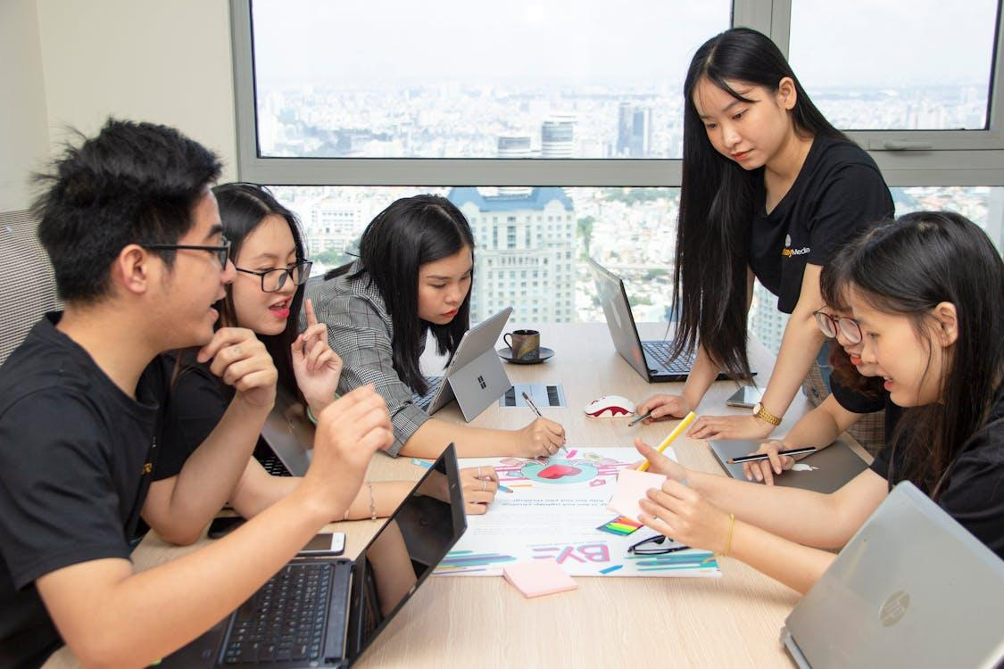
Strategies to enhance social connectedness
Feeds such as those described in the previous slide can even be used to engage one’s team in activities like quizzes or competitions.
Accordingly, we come now to a major contributor to social connectedness in any workplace: teambuilding activities. Some of these events, such as wellbeing exercises (group meditation, workout sessions, etc.) or even classes / seminars (for example on cooking) can be conducted digitally. As with coffee dates, however, it could simply be a good idea to host an in-person teambuilding event every six months or even quarterly. “Real world” bonds developed during these activities will naturally extend into the hybrid workspace.
Photo by Van Tay Media via Pexels.

Slide 26
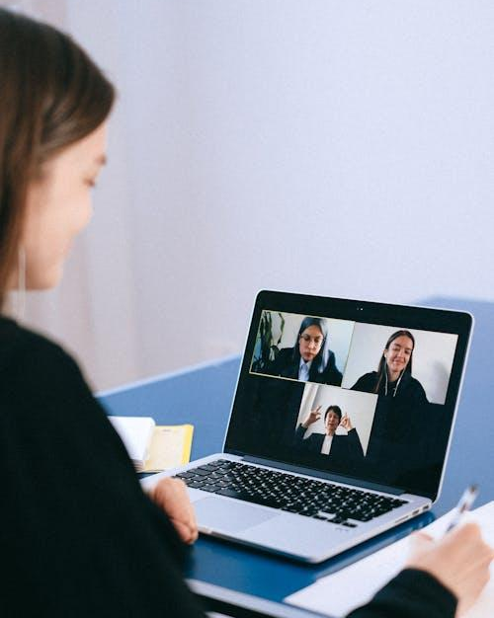
Strategies to enhance social connectedness
Here’s a list of some resources that you can use to try to further enhance your hybrid or remote organisation’s social connectedness.
Remote Video Conferencing Software: The software your organisation needs to facilitate seamless remote communication.
Zoom
Microsoft Teams
Skype
Discord
Shared File Management Solutions: A range of useful file management solutions to help hybrid teams communicate and collaborate effectively.
Google Drive
Microsoft Teams
Freedcamp
Asana
Teamwork
Learning Management Systems: If we are to implement the regular features and functions of in-person employment remotely, then this must extend to our training and professional development. LMSes are innovative platforms designed to facilitate hybrid and remote education, and many examples exist. Moodle is arguably the most well-known.
Resources for Idea and Content Generation: We’ve practised some brainstorming activities in today’s session, but these can be quite difficult to recreate in a remote or hybrid context. Organisations are using software like Mentimeter to conduct anonymous live surveys with colleagues during meetings, allowing staff to contribute their opinions and ideas. Alternatively, many collaborative digital “whiteboard” websites exist, allowing employees to populate a shared document with information in real time.
Photo by Anna Shvets via Pexels.

Slide 27
Strategies to enhance social connectedness
In Summary…
In-Person:
“Water cooler chats”
Desk neighbours
Teambuilding events
Coffee dates
Hybrid / Remote:
Randomised five minute catch-ups
Informal mentoring over longer periods
Remote teambuilding activities / events
Coffee dates! (in-person or virtual)

Slide 28
Strategies to enhance social connectedness
Activity: Collaborative Tool Catalogue
The aim of this activity is to develop learners’ understanding of the strategies and digital tools that can be leveraged to enhance social connectedness in the remote or digital workplace
Learning new knowledge
After the completion of this activity you will be able to:
Develop strategies to create and sustain meaningful connections among team members, regardless of their physical location.
Utilise digital tools and platforms effectively to support communication and collaboration in a hybrid setting.
Flexibility to new, innovative approaches and digital tools to maximise social connectedness.
Materials Required:
Paper, flipchart, sticky notes, etc.
Pens, markers, etc.

Slide 29
Strategies to enhance social connectedness, Activity: Collaborative Tool Catalogue
Split into four groups. Each group should then be assigned one of the following subtopics.
Group 1: Remote Video Conferencing Software
We previously listed Zoom, Microsoft Teams, Skype, and Discord as effective tools for remote video conferencing. Find a few more examples of software that can be used for this purpose, and create a short list of pros and cons for each.
Group 2: Shared File Management Solutions
Google Drive, Microsoft Teams, Freedcamp, Asana,Teamwork, etc. Find a few more examples of software that can be used for this purpose, and create a short list of pros and cons for each.
Group 3: Learning Management Systems
We referenced Moodle earlier. Find a few more examples of software that can be used for this purpose, and create a short list of pros and cons for each.
Group 4: Resources for Idea and Content Generation
We referenced Mentimeter earlier. Find a few more examples of software that can be used for this purpose, and create a short list of pros and cons for each.

Slide 30
Strategies to enhance social connectedness, Activity: Collaborative Tool Catalogue
Now that you have drafted a list of pros and cons for each of the four types of collaborate remote software, come back together and discuss your findings. Together, narrow down a definitive list of what you believe to be the most effective resources for remote and hybrid collaboration.
With reference to the strategies discussed earlier (remote coffee dates, teambuilding activities, mentoring, etc.), which of the digital tools do you think could be especially useful? Why?
What difficulties might arise from the listed tools in terms of social connectedness? How might they be overcome?
Have you ever used any of the digital tools listed? What was your experience like? What are some of the specific strengths and weaknesses you encountered using the software?
Be sure to take notes chronicling the answers provided to each of the above questions, and put the list of digital tools to one side. We’ll use this material again in another activity!

Slide 31
Strategies to enhance social connectedness
Learn more!
Interested in exploring this topic further? In this Forbes article, Neal Stanton (Co-CEO at Ramp) discusses some of the many ways to encourage teambuilding in a hybrid or remote workplace.
https://www.forbes.com/councils/forbestechcouncil/2022/08/10/how-to-build-connections-team-building-in-a-hybrid-workplace/

Slide 32
Inclusivity and empathy as cornerstones of connection

Slide 33

Inclusivity and empathy as cornerstones of connection
In any environment, whether that be a remote workplace, a school, or a family unit, every good intention and effort to generate connectedness is worthless without first practising inclusivity and empathy. Truly, the ability to connect on a human level to our peers should be the starting point of any social connectedness strategy.
With this in mind, we’ll supplement the theory, strategies, and digital tools elaborated thus far with some top tips on how best to maximise your organisation’s inclusivity and empathy. Upon completion of this section, you will then be able to bring together all of the above elements to lay out a comprehensive connectedness strategy for your remote or hybrid workplace.
Photo by Antoni Shkraba via Pexels.

Slide 34

Inclusivity and empathy as cornerstones of connection
Just like with social connectedness in the hybrid or remote workplace, some contexts can present barriers to inclusivity and empathy. HR professionals and managers who hope to increase social connectedness in their workplaces should ideally take steps to address these barriers before committing to an inclusivity strategy.
For one, many of our biases and stereotypes are deep-rooted, and some of them are even referred to as “unconscious”; that is, we unknowingly and unwittingly perpetuate them. The first step to addressing these biases is to identify them, and then to commit to developing our behaviour and perceptions such that we grow beyond them.
Another example of a barrier to inclusivity and empathy could be something as simple as preferential allocation of tasks in a workplace. Without any ill will whatsoever, we may inadvertently delegate in a manner which leads to some individuals having fewer opportunities to contribute than others.
By tackling the root roadblocks to inclusivity, we lay the groundwork for a more empathetic workplace environment.
Photo by Alena Darmel via Pexels.

Slide 35

Inclusivity and empathy as cornerstones of connection
Of course, we can move beyond reactive responses to inclusivity and empathy and build on these with some proactive measures. Here’s some quickfire strategies that your organisation can implement to promote these important values.
• Plan for Everyone: Whenever you are tasked with setting up an activity, event, work task, etc., take a moment to reflect on any barriers to physical access, language needs, respect for different cultures, etc., that may need to be considered such that everyone involved feels welcome and included.
• Walk a Mile in Others’ Shoes: The fundamental concept of empathy is to consider and take into account another person’s feelings and perspective. In the workplace, this trait can be especially valuable as it allows us to map out the process by which a person reaches their decisions, the reasons they may communicate in a particular way, their personal driving motivations, etc.
• Reach Out: When in doubt, communicate! Discuss the ways in which your organisation can become more accommodating and inclusive. Your staff will appreciate the effort being made, and this can only further enhance the company’s social connectedness.
Photo by Alex Green via Pexels.

Slide 36
Inclusivity and empathy as cornerstones of connection
Activity: Roleplay Scenario
The aim of this activity is to practice empathy in action through role-playing scenarios that address common hybrid workplace challenges. Learners will reflect on how to encourage a culture of inclusivity and adapt to the unique needs of remote employees.
Learning new knowledge
After the completion of this activity you will be able to:
Recognise the role of leadership and the wider organisation in developing an inclusive, connected workplace environment across physical and virtual spaces.
Committed to hybrid workplace inclusivity, ensuring remote employees feel valued and involved in the workplace culture.
Empathetic towards hybrid employees' social and emotional needs.

Slide 37
Inclusivity and empathy as cornerstones of connection
Activity: Roleplay Scenario
Group up!
Let’s get started by splitting into smaller groups, ideally comprising 3-4 participants. Assign a role to each group member, with one person each representing:
Employee
HR
Manager
Observer (in the case there is a fourth group member)
Read the following scenario:
The Employee, who works remotely, has recently expressed feeling excluded from important team decisions and some of the informal interactions in a way that in-office staff are not currently experiencing. They feel that a number of their recent contributions in meetings have been overlooked, and are unsure that their efforts are being valued. This is starting to affect the Employee’s engagement and morale, and they have scheduled a meeting with HR, their direct Manager, and (optionally) an Observer to potentially resolve this.

Slide 38
Inclusivity and empathy as cornerstones of connection
Activity: Roleplay Scenario
Scenario: The Employee, who works remotely, has recently expressed feeling excluded from important team decisions and some of the informal interactions in a way that in-office staff are not currently experiencing. They feel that a number of their recent contributions in meetings have been overlooked, and are unsure that their efforts are being valued. This is starting to affect the Employee’s engagement and morale, and they have scheduled a meeting with HR, their direct Manager, and (optionally) an Observer to potentially resolve this.
Considering your approach…
Every party to this discussion has different requirements and suggested best practices. Try to map out how a constructive meeting between them might look, in a context where everyone is well-versed in empathy and inclusivity.
Employee: Communicate concerns in an honest, calm, and constructive manner.
HR: Actively listen to the Employee’s concerns, acknowledging their feelings, and providing potential solutions.
Manager: Work alongside HR to ensure that the Employee feels heard, as well as offering potential solutions that could be implemented during the course of regular work.
Observer: Monitor the discussion, providing insights on areas of strength and areas where improvement may be needed to maximise the effectiveness of the meeting.

Slide 39
Inclusivity and empathy as cornerstones of connection
Activity: Roleplay Scenario
Debrief: Now that you have worked your way through this hypothetical scenario, you are invited to contribute your thoughts and feelings about the efficacy of the discussion. What worked, and what could use improvement, for example? Here are some other sample questions to inspire conversation:
In what ways did the HR and Manager demonstrate empathy and inclusivity?
Were the solutions provided by them realistic and actionable? How likely do you think it is that the ideas offered would resolve the situation amicably for all parties?
What can the solutions offered teach us about inclusivity and empathy best practices?
In what ways do you think inclusivity and empathy impact social connectedness in an organisation?
What aspects of this roleplay scenario would you like to see incorporated into your own workplace?

Slide 40
Inclusivity and empathy as cornerstones of connection
Learn more!
Inclusivity and empathy are vital components of any well socially-connected organisation, but parsing through all of the resources out there and having a constructive discussion on these topics can sometimes feel a little overwhelming. That’s OK! We’ve hand-picked a few resources that you can use to explore these subjects further in your own time.
Inclusion Starts with Empathy | Empathy Employer
How to foster an empathetic and inclusive culture in your organization | Abigail Dunne-Moses
Building a Culture of Empathy in the Workplace | MSS, The HR People

Slide 41
Mapping Your Ideas

Slide 42

Mapping your Ideas
You’ve learned the theory behind social connectedness and its importance in remote contexts, researched its challenges, and devised some strategies to enhance it. You’ve even begun exploring the topics of inclusivity and empathy, demonstrating an admirable commitment to organisational improvement.
In this final section, we will take the many concepts discussed thus far and use them to create a n idea map for your organisation’s future social connectedness.
Photo by Anna Shvets via Pexels.

Slide 43
Mapping your Ideas: Your Social Connectedness Blueprint
The aim of this activity is for learners to take the many lessons imparted thus far and combine them to develop a Social Connectedness Blueprint that maps their ideas on how they can enhance their organisation’s social connectedness
Learning new knowledge
After the completion of this activity you will be able to:
Design initiatives, events, and routines that encourage meaningful and impactful interaction within hybrid teams
Demonstrate flexibility to new, innovative approaches and digital tools to maximise social connectedness.
Utilise digital tools and platforms effectively to support communication and collaboration in a hybrid setting.
Recognise the role of leadership and the wider organisation in developing an inclusive, connected workplace environment across physical and virtual spaces.
Materials Required:
Social Connectedness Blueprint Handout
Paper, flipchart, sticky notes, etc.
Pens, markers, etc.
Collaborative Tool Catalogue from Topic 3’s activity
Presentation / reading materials provided

Slide 44
Mapping your Ideas: Your Social Connectedness Blueprint
Aim: To reflect on the strategies learned and create a personalised vision or list of ideas to bring more social connectedness to your hybrid/remote team.
Instructions (Individual or Small Group):
Vision Statement Think about what a truly connected hybrid workplace would look like in a perfect world. Now write a short, inspiring statement that captures your long-term aspiration for workplace connectedness. (Example: “We want every team member to feel seen, heard and valued, no matter where they work from”).
Map your Ideas Write down 4 small but meaningful ideas you’d like to try, suggest, or share at your workplace that could improve connectedness. These could include things like:
Hosting monthly “Virtual Coffee Roulette” sessions
Creating a birthday shoutout channel on Teams
Proposing a buddy system for new remote hires
Choose One “Quick Win” Pick one idea that feels doable right now. What would be the first step?
Optional Pair & Share In pairs or small groups, invite participants to share one idea from their blueprint and offer feedback or suggestions.

Slide 45
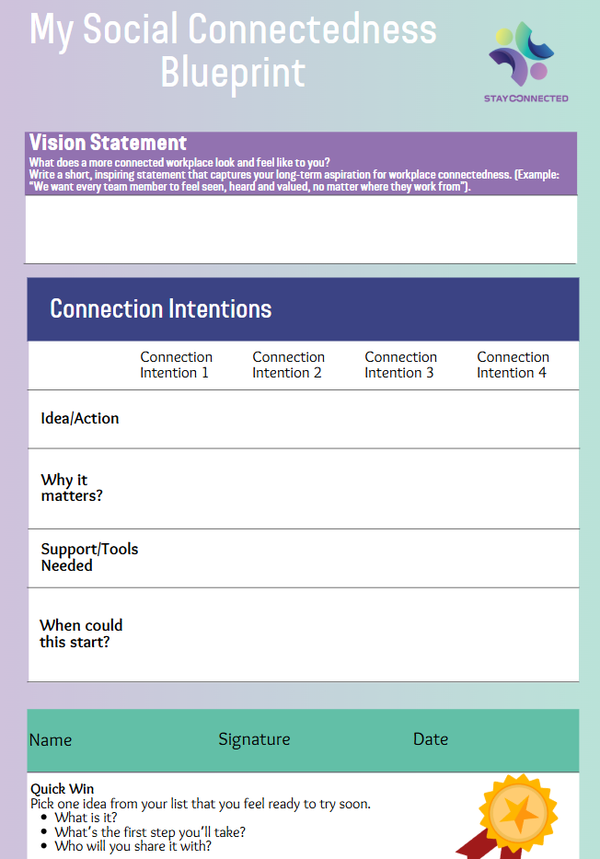
Mapping your Ideas: Your Social Connectedness Blueprint
A suggested template for your organisation’s Social Connectedness Blueprint can be found on the left. Your trainer will be able to provide an editable version of this document, which can also be accessed online here.
As you begin shaping your blueprint, keep the following tips in mind:
Start with your vision. Keep your “vision statement” short, inspiring, and forward-looking. It should reflect a meaningful aspiration for how your workplace could feel more connected. Something to work toward over time.
Follow with practical intentions. These can be small actions, ideas, or habits that help bring your vision to life. Think about what’s realistic, what support or resources might be needed, and what timeframe feels right.
Remember, your Connectedness Blueprint doesn’t have to be perfect or final. Think of it as a living document that captures your evolving ideas for a more inclusive and connected workplace.

Slide 46
Closing Remarks and Q&A

Slide 47
Closing Remarks and Q&A
Congratulations! You have now completed Module 4 of the StayConnected Training Programme for HR Professionals and Managers, “How to facilitate social connectedness in hybrid workplaces”. Throughout this module, you covered the topics “understanding social connectedness”, “challenges in hybrid and remote workplaces”, “strategies to enhance social connectedness”, “inclusivity and empathy as cornerstones of connection”, and “mapping your ideas”. Well done!
Before you advance with the remainder of this programme, do you have any questions?
Notes:
DELETE ALL NOTES AT THE END
- include LU number and title

Slide 48
Bibliography
Crummenerl, C. et al. (2020) The Future of Work: From remote to hybrid, capgemini.com. Available at: https://www.capgemini.com/wp-content/uploads/2020/12/Report-The-Future-of-Work.pdf.
Daly, T. (2024) Building a Culture of Empathy in the Workplace, MSS The HR and Recruitment Specialists. Available at: https://www.mssthehrpeople.ie/building-a-culture-of-empathy-in-the-workplace.
Dunne-Moses, A. (2022) How to foster an empathetic and inclusive culture in your organization, Chief Talent Officer. Available at: https://www.chieftalentofficer.co/2022/06/08/how-to-foster-an-empathetic-and-inclusive-culture-in-your-organization.
Empathy Employer (2024) Inclusion Starts with Empathy - Comprehensive Guide, Empathy Employer. Available at: https://empathyemployer.com/inclusion-starts-with-empathy/.
Haas, M. (2022) 5 Challenges of Hybrid Work - and How to Overcome Them, Harvard Business Review. Available at: https://hbr.org/2022/02/5-challenges-of-hybrid-work-and-how-to-overcome-them.
Holt-Lunstad J. (2018) Why Social Relationships Are Important for Physical Health: A Systems Approach to Understanding and Modifying Risk and Protection. Annu Rev Psychol. 69, 437-458.
Lee, R. M., & Robbins, S. B. (1995). Measuring belongingness: The Social Connectedness and the Social Assurance scales. Journal of Counseling Psychology, 42(2), 232–241. https://doi.org/10.1037/0022-0167.42.2.232.
O’Reilly, M. (2023) Belonging in the era of remote and hybrid work, IBEC. Available at: https://www.ibec.ie/connect-and-learn/insights/insights/2023/11/28/belonging-in-the-era-of-remote-and-hybrid-work.
Stanton, N. (2022) Council post: How to Build Connections: Team Building in a Hybrid Workplace, Forbes. Available at: https://www.forbes.com/councils/forbestechcouncil/2022/08/10/how-to-build-connections-team-building-in-a-hybrid-workplace/.
Zhao, Z., Wan, R. and Ma, J. (2022) ‘Social change and birth cohorts decreased resilience among college students in China: A cross-temporal meta-analysis, 2007–2020’, Personality and Individual Differences, 196. doi:10.1016/j.paid.2022.111716.
Notes:
DELETE ALL NOTES AT THE END
- include LU number and title

Slide 49
The Rural Hub, Ireland
theruralhub.ie
Notes:
DELETE ALL NOTES AT THE END
- complete contente developer partner information

Slide 50









Funded by the European Union. Views and opinions expressed are however those of the author(s) only and do not necessarily reflect those of the European Union or the European Education and Culture Executive Agency (EACEA). Neither the European Union nor EACEA can be held responsible for them. Project Number: 2023-1-BG01-KA220-VET-000153460

